Slide 1


Slide 2
Proposed Budget
FY 2026
Green Valley Recreation

Slide 3
2026 Budget Goal
The Proposed 2026 Budget meets GVR’s mission of providing excellent facilities and services that create opportunities for recreation, social activities, and leisure education to enhance the quality of our members’ lives.
The Proposed 2026 Budget meets Goal #4 of the Strategic Plan, to cultivate and maintain a sound financial base that generates good value for our members
The 2026 Recommended Operational Budget is based on the actual expenditures that GVR anticipates for 2026, per Bylaws Article 3. Section 2.

Slide 4
2026 Budget Goal continued
Corporate Policy Manual (CPM)
Section 5.5.2
B. Annually, staff will prepare a tentative budget calendar based on a required budget approval of no later than November 15.
C. GVR shall annually adopt a balanced budget where operating revenues are equal to, or exceed, operating expenditures.

Slide 5
Budget Development
The Budget process began in August 2025 when the CEO and CFO met with each department director to review and discuss their budget needs and requests
Staff presented a draft 5-Yr Capital Plan to the Planning and Evaluation Committee (P&E) on August 14th
Staff developed a draft budget that the Fiscal Affairs Committee (FAC) reviewed on September 16th and developed a Recommended Budget on September 23rd
Staff provided revisions to the FAC’s Recommended Budget based on updated wage information
The Revised P&E and FAC Recommended Budget and a “Plan B” Alternative Budget were presented to the Board in work session on October 8th

Slide 6
FAC Revised & Recommended Budget
OPERATIONS:
Membership dues rate increase from current $530 to $538 (1.5%).
Membership Change Fee and Initial Fee increase from $3,100 to $3,200 (3.2%).
Eliminate Member Change Fee (MCF) refunds other than those required by law, in order to generate additional revenue. This change is proposed to occur mid-year 2026 and would generate approximately $150,000 in new revenue in 2026 and $300,000 in subsequent years.
Aggregate wage increase of $177,601 (4.0%).
Tenant Pass modified to break out separate fees for tenants that stay longer than 4 months or more.
Increase Additional Card Holder Pass fee.
Increase Professional Fees expenses by $10,000 to allow for improved digital marketing.

Slide 7
FAC Revised & Recommended Budget
CAPITAL:
No funds in the Initiatives Fund to replace the ABS locker and showers building.
No funds in the MRR-B Fund (Pools and Spas) to replace the ABS pool and spa.
Include $100,000 in the Initiatives Fund for demolition of the ABS pool and locker room facilities.
Begin Woodshop Facility Expansion Project in 2026 as result of eliminating funding for rebuilding ABS locker room facilities.
Include $20,000 in the Non-Reserve Capital Fund (NRC) for ADA improvements.
Increase funding to the Initiatives Fund by approximately $30,080 in 2026 due to change in MCF refund policy elimination.
Increase 2026 funding of MRR-B Pools and Spas by $7,761 for a total of $342,783 to meet the 7% escalation in annual funding goal.
Transfer from the Operations Funds to the Maintenance Repair and Replacement Part A Fund (MRR-A) is $1,400,102.
Capital projects expenditures for (MRR-A) anticipated is $2,532,877.

Slide 8
FAC Revised & Recommended Budget
THREE YEAR FORECAST ANTICIPATED DUES:
Year | Forecasted Dues Rate | Forecasted Increase
2027 | $557 | 3.4%
2028 | $567 | 1.8%
2029 | $581 | 2.5%

Slide 9
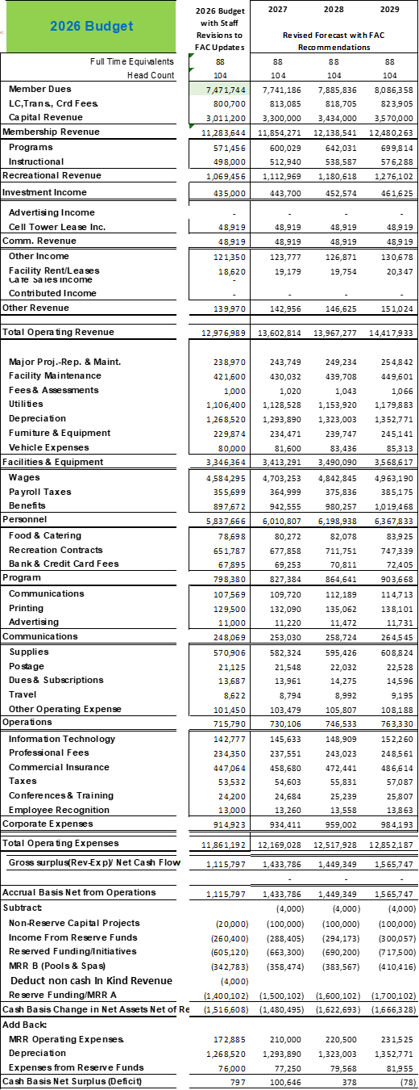
FAC Revised & Recommended Budget
THREE YEAR FORECAST ANTICIPATED DUES:

Slide 10
“Plan B” Alternative Budget
THREE YEAR FORECAST ANTICIPATED DUES:
OPERATIONS:
Membership dues rate increase from current $530 to $545 (2.8%).
Membership Change Fee and Initial Fee increase from $3,100 to $3,200 (3.2%).
No elimination of Member Change Fee (MCF) refunds.
Aggregate wage increase of $177,601 (4.0%).
Tenant Pass modified to break out separate fees for tenants that stay longer than 4 months or more.
Increase Additional Card Holder Pass fee.
Increase Professional Fees expenses by $10,000 to allow for improved digital marketing.

Slide 11
“Plan B” Alternative Budget
THREE YEAR FORECAST ANTICIPATED DUES:
CAPITAL:
Funds included in the Initiatives Fund to replace the ABS locker and showers building.
Funds included in the MRR-B Fund (Pools and Spas) to replace the ABS pool and spa.
Begin Woodshop Facility Expansion Project in 2027 as a result of including funding for rebuilding ABS locker room facilities.
Include $20,000 in the Non-Reserve Capital Fund (NRC) for ADA improvements.
Increase 2026 funding of MRR-B Pools and Spas by $7,761 for a total of $342,783 to meet the 7% escalation in annual funding goal.
Transfer from the Operations Funds to the Maintenance Repair and Replacement Part A Fund (MRR-A) is $1,400,102.
Capital projects expenditures for (MRR-A) anticipated is $2,532,877.

Slide 12
“Plan B” Alternative Budget
THREE YEAR FORECAST ANTICIPATED DUES:
THREE YEAR FORECAST ANTICIPATED DUES:
Year | Forecasted Dues Rate | Forecasted Increase
2027 | $575 | 5.5%
2028 | $597 | 3.8%
2029 | $618 | 3.5%

Slide 13
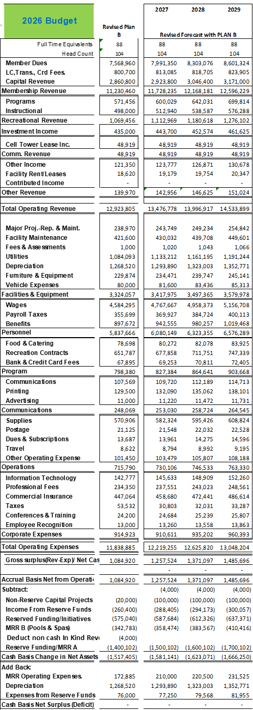
“Plan B” Alternative Budget
THREE YEAR FORECAST ANTICIPATED DUES:
THREE YEAR FORECAST ANTICIPATED DUES:

Slide 14
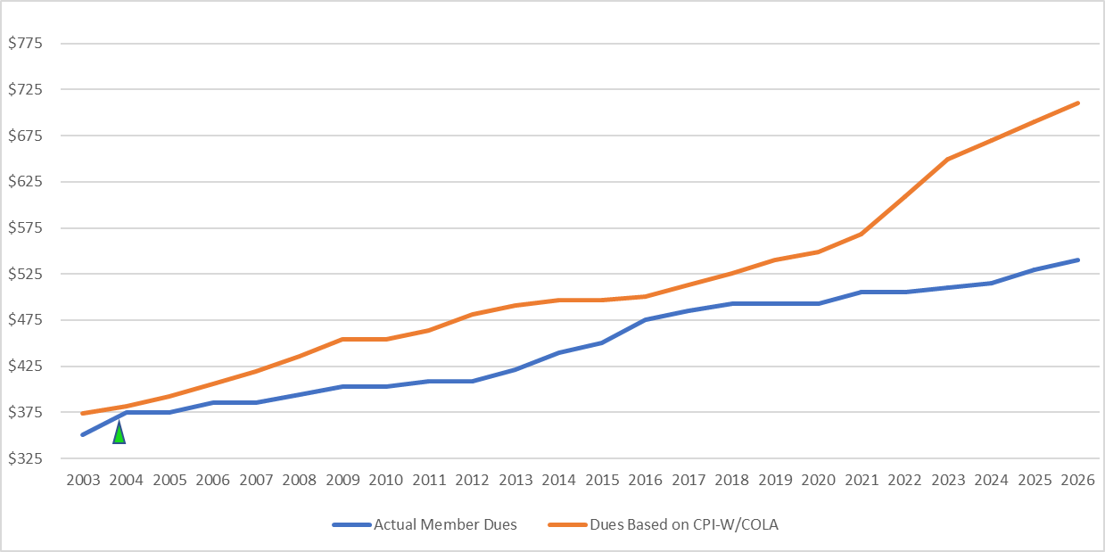
Primary Revenue Sources
Dues increases have not kept up with cost of living since 2004. Page 8 of the Budget Message

Slide 15
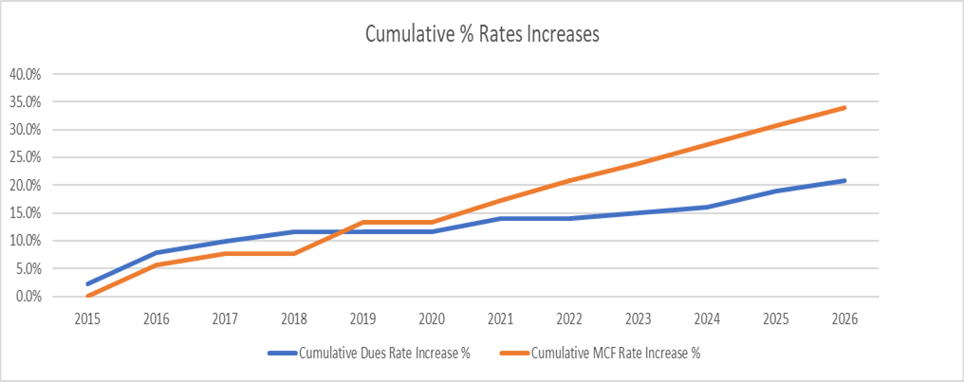
Primary Revenue Sources – Dues and MCF Fees
Starting in 2019, the MCF rate increases have outpaced increases in dues. Page 10 of the Budget Message

Slide 16
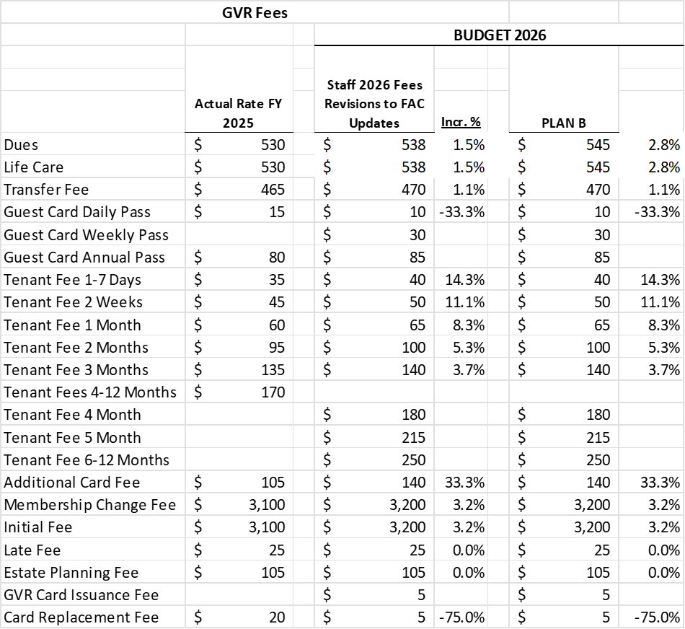
Recommended Fees and Dues

Slide 17
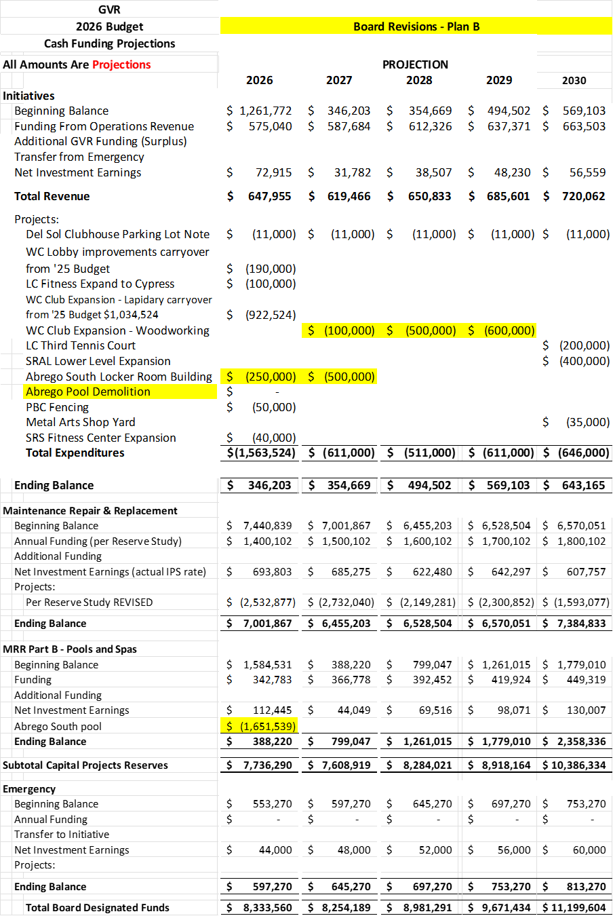
5-Year Capital Plan

Slide 18
Maintenance, Repair, & Replace Fund (MRR-A)
The Reserve Study recommended increases to annual funding due to increased annual expenditures due to:
  Increased execution of the plan (more planned repairs and maintenance components are being performed).
  Inflationary pressures.
The annual budgeted contributions to the MRR-A fund have been increased about $100,000 for 2026 with additional escalations for future years.

Slide 19
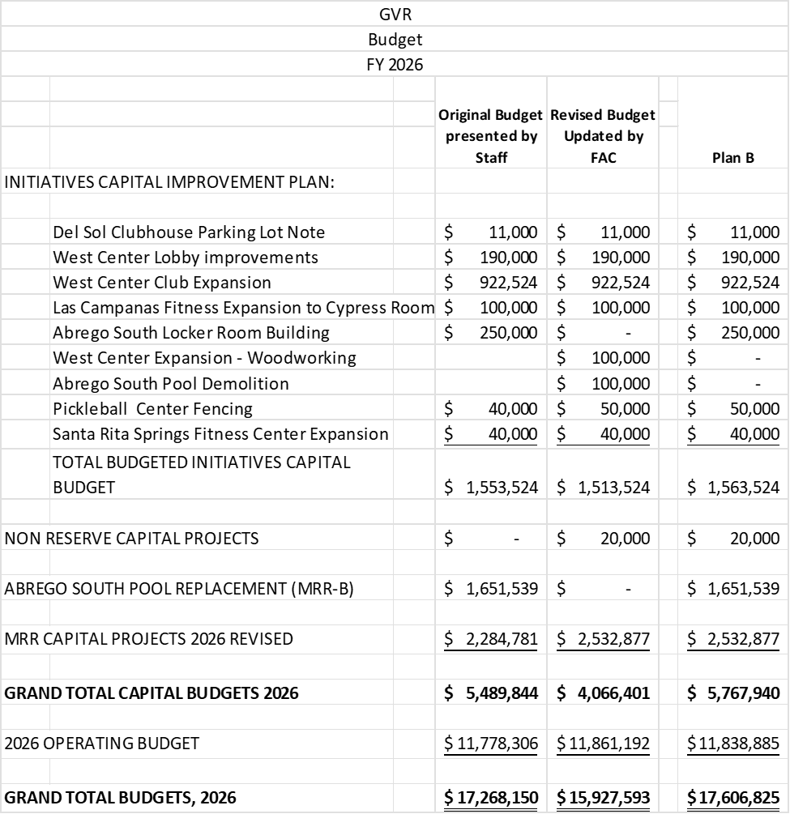
Recommended Total Budget

Slide 20
Board Options
1) Adopt the Fiscal Affairs Committee (FAC) and Staff Revised Recommended 2026 Operating and Capital Budgets, the Five-Year Capital Improvement Plan, and the 2026 Fee Schedule as presented or with amendments.
2) Adopt the “Plan B” 2026 Operating and Capital Budgets, the Five-Year Capital Improvement Plan, and the 2026 Fee Schedule as presented or with amendments.
3) Direct staff to conduct additional research and finalized adoption of the Operating and Capital Budgets no later than November 15, 2025 as prescribed by the Corporate Policy Manual (CPM).

Slide 21
Staff Recommendation
2) Adopt the “Plan B” 2026 Operating and Capital Budgets, the Five-Year Capital Improvement Plan, and the 2026 Fee Schedule as presented or with amendments.

Slide 22
Recommended Motion
I move to adopt the “Plan B” 2026 Operating and Capital Budgets, the Five-Year Capital Improvement Plan, and the 2026 Fee Schedule as presented.

Slide 23
Questions?

Slide 24
Thank You!

