Slide 1

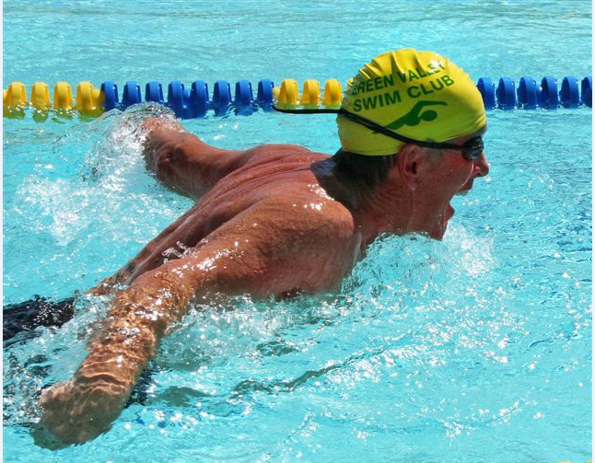
2024
Year in
Review
Providing excellent facilities and services that create opportunities for recreation, social activities, and leisure education to enhance the quality of our members’ lives.
Annual Meeting
2025

Slide 2
2024 Year in Review
2024 Snapshot of GVR
2024 Accomplishments
2025 Goals and Projects

Slide 3
2024 Snapshot of GVR

Slide 4
MaMarch 28 at 6pmrch 28 at 6pm
2024 Snapshot of GVR
13,872
Individual Households
Increase of 22 over 2023
March 28 at 6pm
22,335
Individual Members
Decrease of 7 over 2023
Notes:
**Please note that the Change from Last Year number for Member Households will look to be more than 22. Please report the increase as 22 even though the math does not add up. We are changing the way we report numbers beginning with 2024. (I reviewed this with Barb and she and I decided we would change the reporting method this year.)

Slide 5
2024 Snapshot of GVR
By the Decade
1910s babies
1920s babies
1930s babies
1940s babies
1950s babies
1960s babies
1970s babies
1980s babies
1990s babies
9
195
2,150
8,122
7,010
2,234
364
90
131
Most popular birth year: 1947

Slide 6
2024 Snapshot of GVR
1,535
Guest Passes Issued
Increase of 95 over 2023
1,181
Tenant Passes Issued
Decrease of 69 over 2023
87
LifeCare Member Passes Issued
Increase of 13 over 2023

Slide 7
2024 Snapshot of GVR
Centers
7
Major Centers
8
Satellite Centers
March 28 at 6pm

Slide 8
2024 Snapshot of GVR
Centers
176,283
Square Feet
57
Acres
March 28 at 6pm
Notes:
West center acreage includes the AO and metal shop yard.

Slide 9
Pools & Spas
26
Pools & Spas
1,172,377
Gallons in Pools
March 28 at 6pm

Slide 10
Pools & Spas
38,236
Gallons in Spas
1,210,613
Gallons in Pools & Spas
March 28 at 6pm

Slide 11
2024 Snapshot of GVR
Board of Directors
13
People served on the
Board of Directors
28
Members served on Board Committees
March 28 at 6pm

Slide 12
2024 Snapshot of GVR
Board of Directors
372
Hours served in Board
Meetings (Estimated)
372.5
Hours served on Board Committees
(Estimated)
Notes:
Hours served in Board Meetings = 31 Meeting Hours x 12 directors = 372. Hours served on Board Committees = The total of six Board Committees, the members of those Committees x Meeting Hours = 372.5.

Slide 13
2024 Snapshot of GVR
Staff
80
Full-Time Staff
24
Part-Time Staff
March 28 at 6pm

Slide 14
2024 Snapshot of GVR
GVR by the Numbers
Events and Entertainment
6,767
Total Audience
Increase of 35% over 2023
65
Total Events
March 28 at 6pm
Increase of 97% over 2023

Slide 15
2024 Snapshot of GVR
GVR by the Numbers
Events and Entertainment
116
Volunteers
Increase of 26% over 2023
New Event and Entertainment Offerings Include:
Tours, Paint ‘n Sips, Wine ‘n Design, Trivia, Karaoke, Clubhouse Events, Holiday Socials
March 28 at 6pm

Slide 16
2024 Snapshot of GVR
GVR by the Numbers
Facilities Maintenance
4,212
Completed
Work Orders

Slide 17
2024 Snapshot of GVR
GVR by the Numbers
Clubs
57
Clubs
Two disbanded: New England Club and GVR Valley Players
10,352
Club Members
March 28 at 6pm
699 more than 2023
Notes:
GVR Valley Players Club provided live theater performances. GVR Travel Club dissolved 1/31/2025 (So, they were in the process of dissolving at the end of 2024 but not yet dissolved.)

Slide 18
2024 Snapshot of GVR
GVR by the Numbers
GVR’s Most Popular Clubs

Slide 19
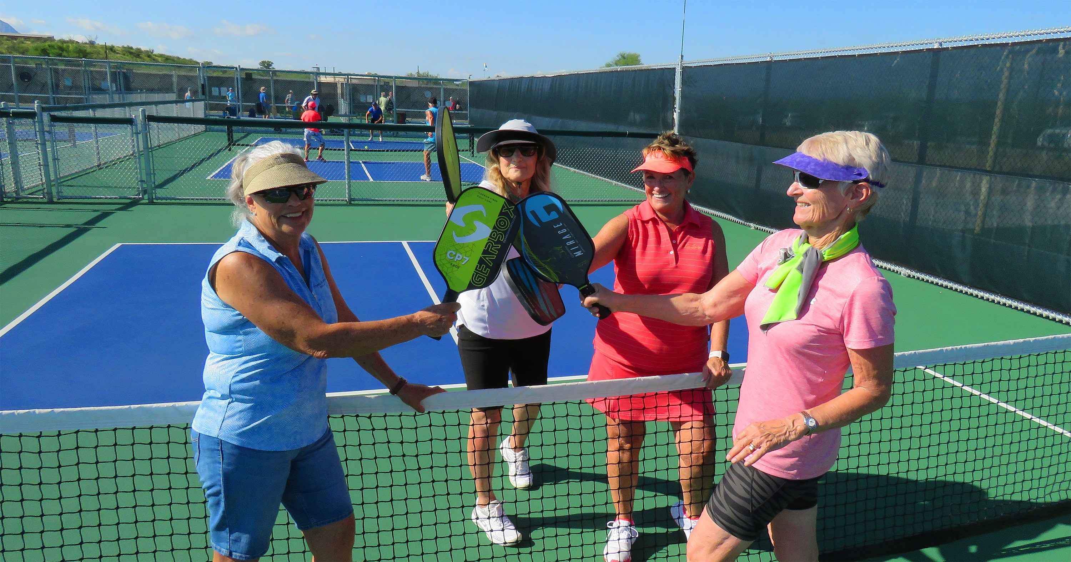
2024 Snapshot of GVR
GVR by the Numbers
Number One: Pickleball, 1,237 Members
Increase of 254 members over 2023

Slide 20
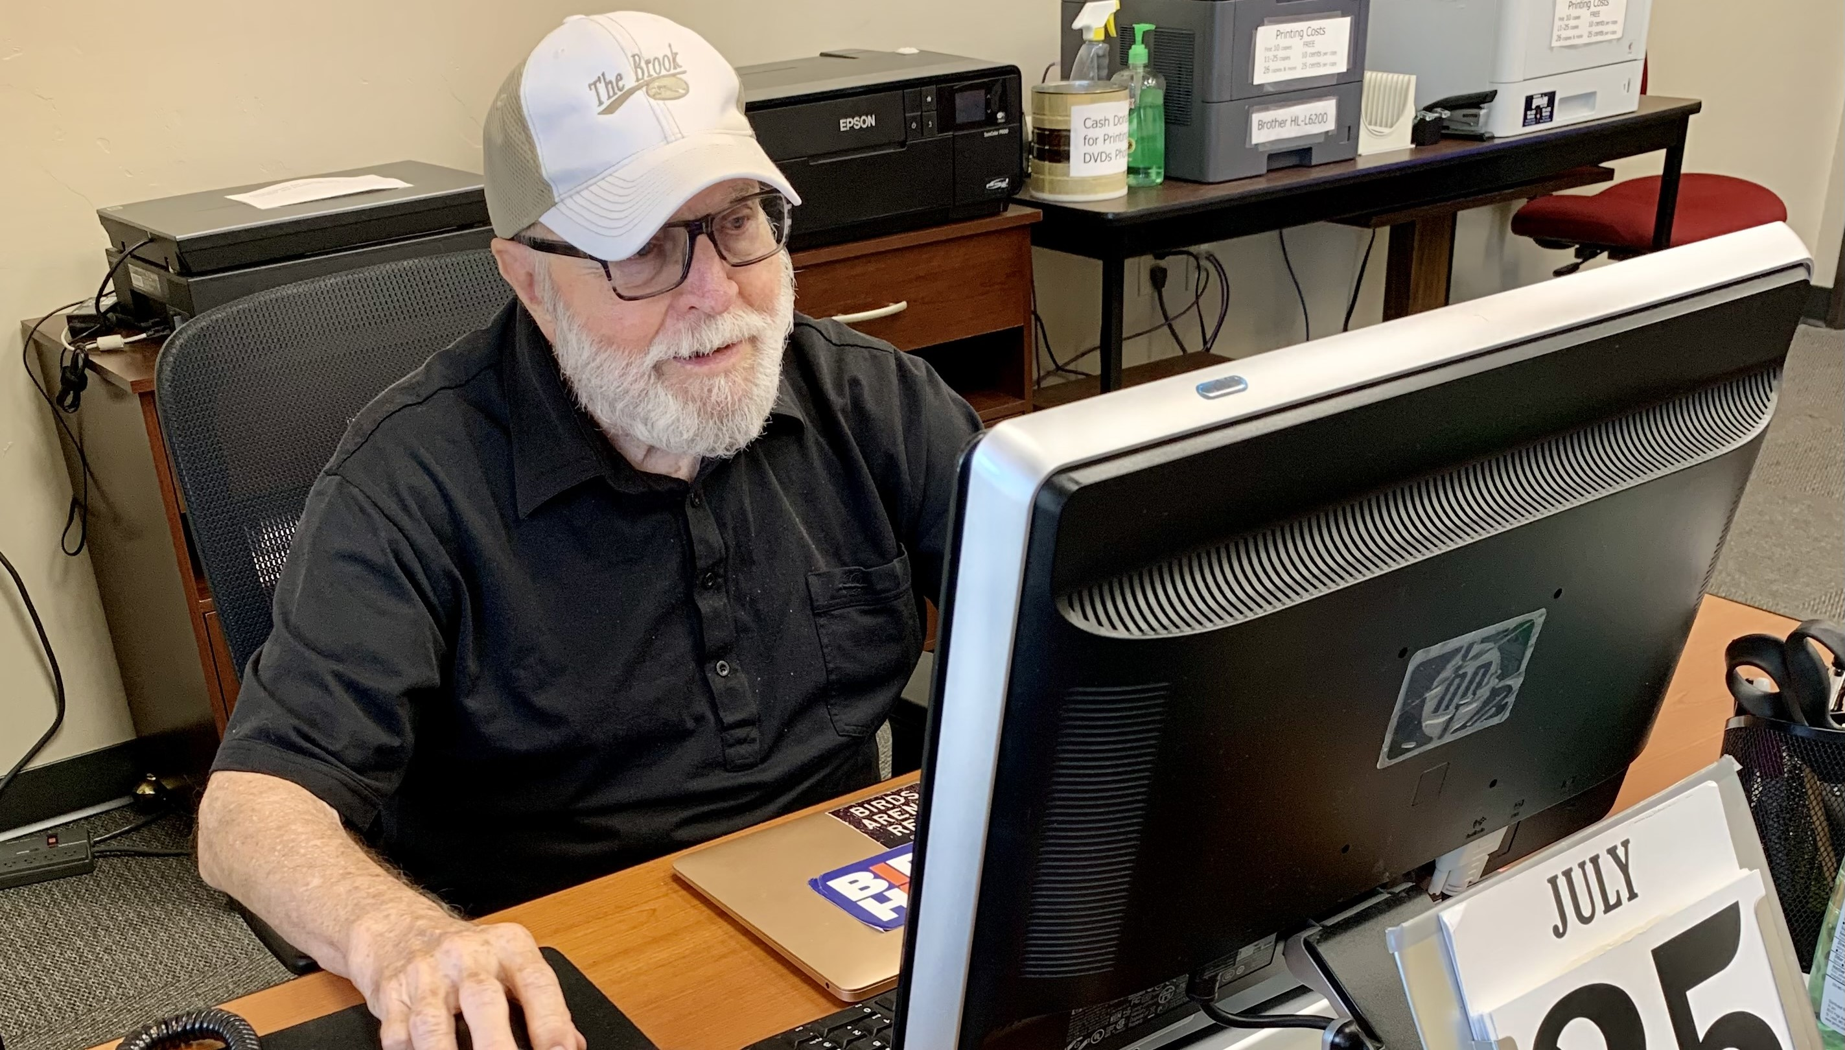
2024 Snapshot of GVR
GVR by the Numbers
Number Two: Computer, 797 Members
Decrease of 56 members since 2023

Slide 21
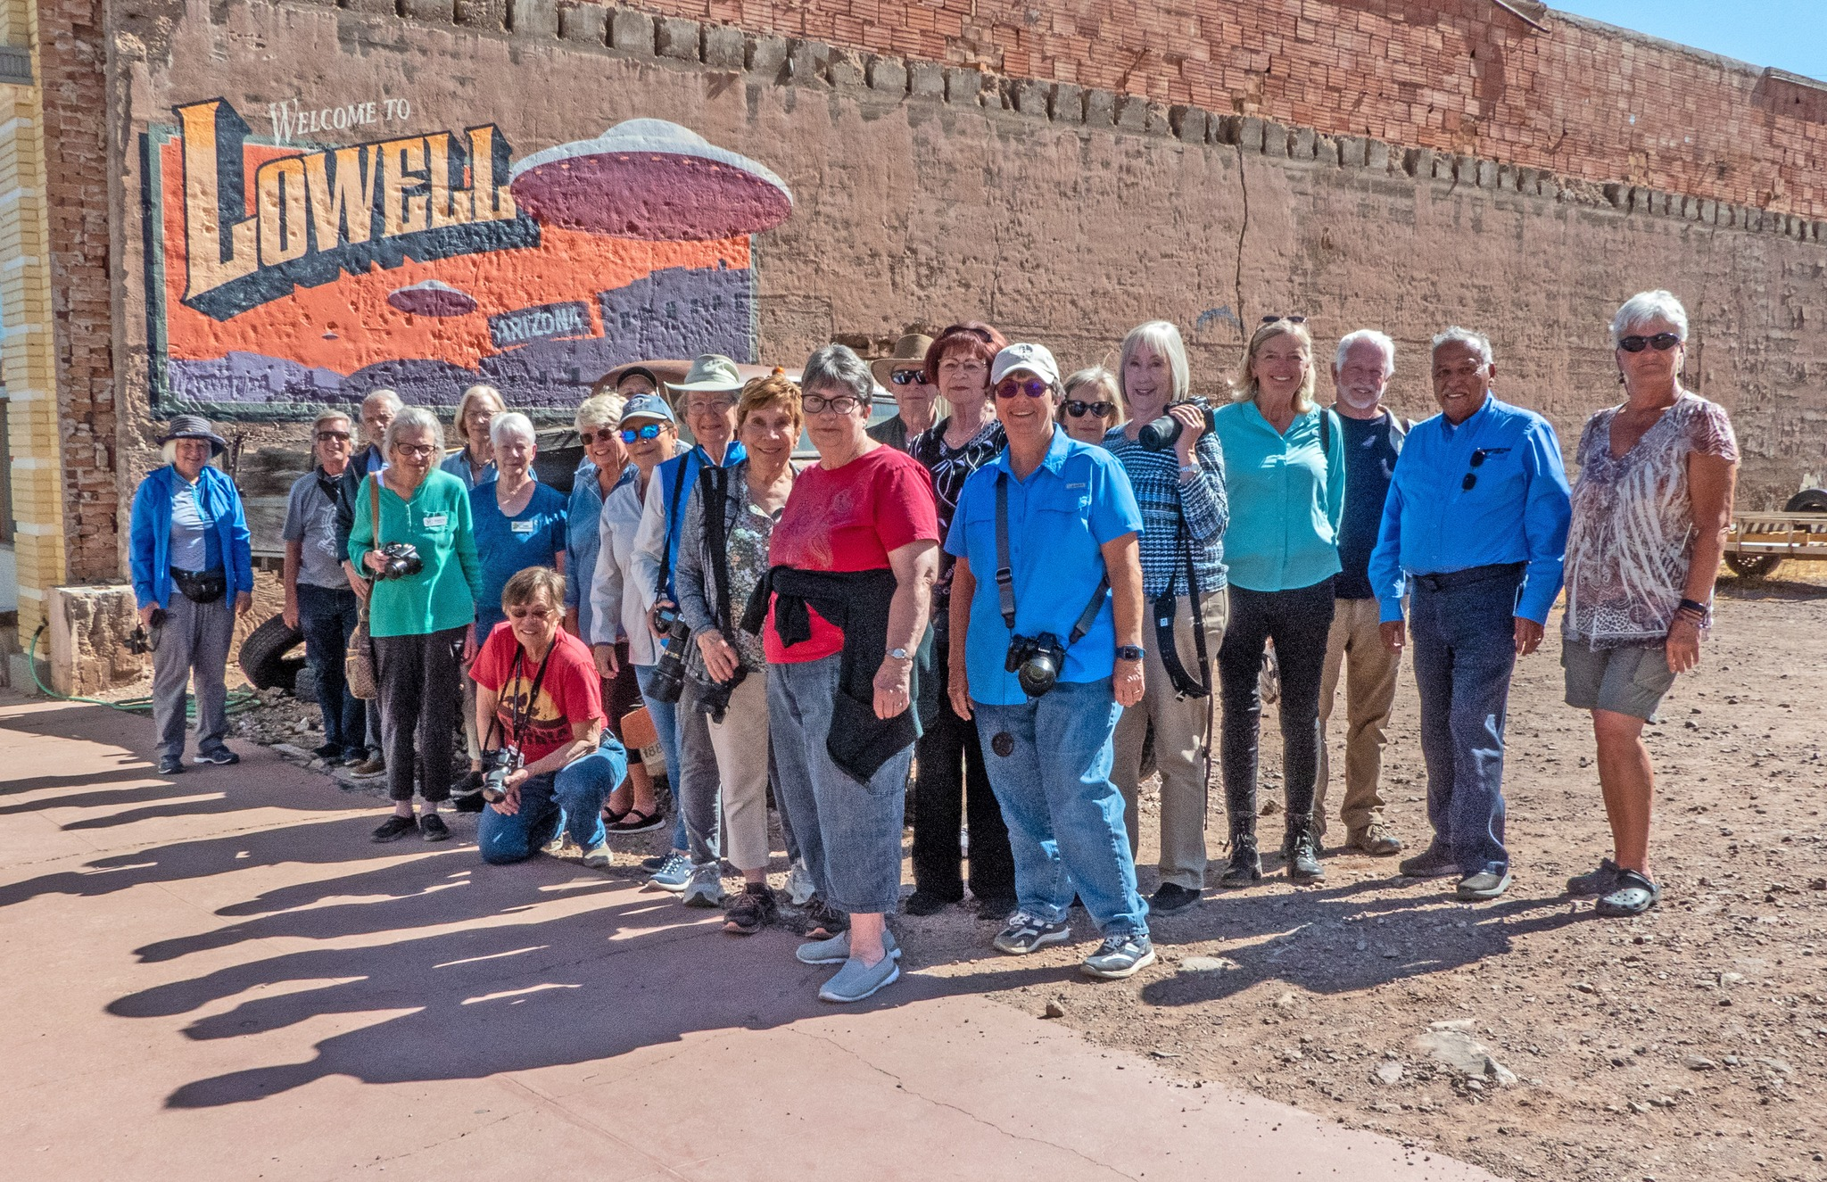
2024 Snapshot of GVR
GVR by the Numbers
Number Three: Photography, 651 Members
No change since 2023

Slide 22
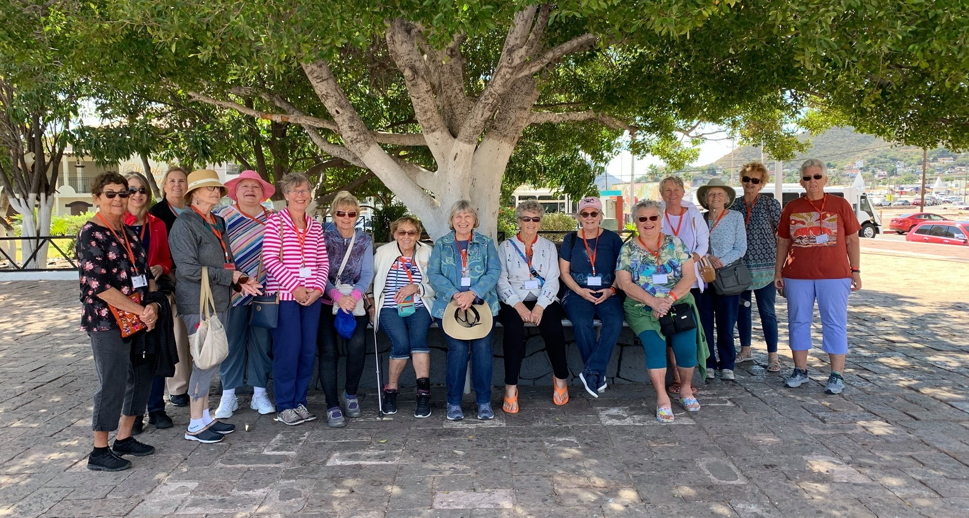
2024 Snapshot of GVR
GVR by the Numbers
Number Four: Amigas, 638 Members
Increase of 214 members over 2023
Notes:
Amigas were number five last year with 424 members.

Slide 23
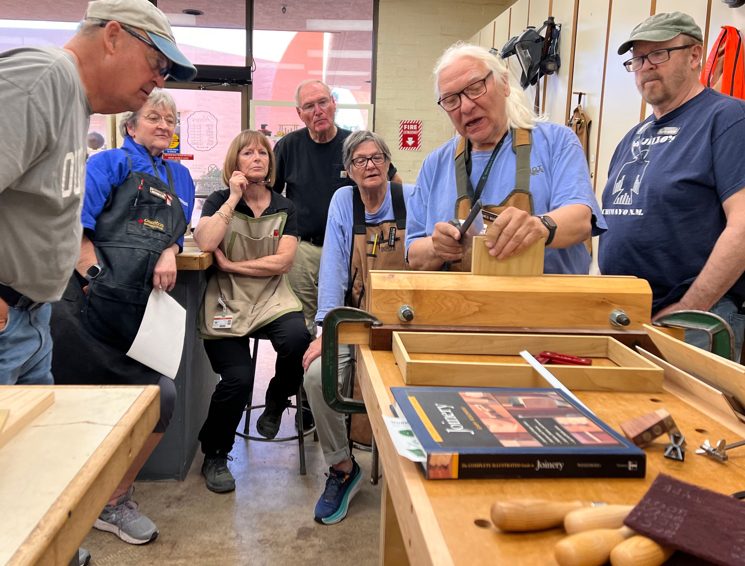
2024 Snapshot of GVR
GVR by the Numbers
Number Five: Woodworkers, 571 Members
Increase of 3 members over 2023
Notes:
Woodworkers were number four last year with 468 members. Member number count methodology changed from 2023 to 2024. This is most noticeable with Woodworkers numbers should it come up.

Slide 24
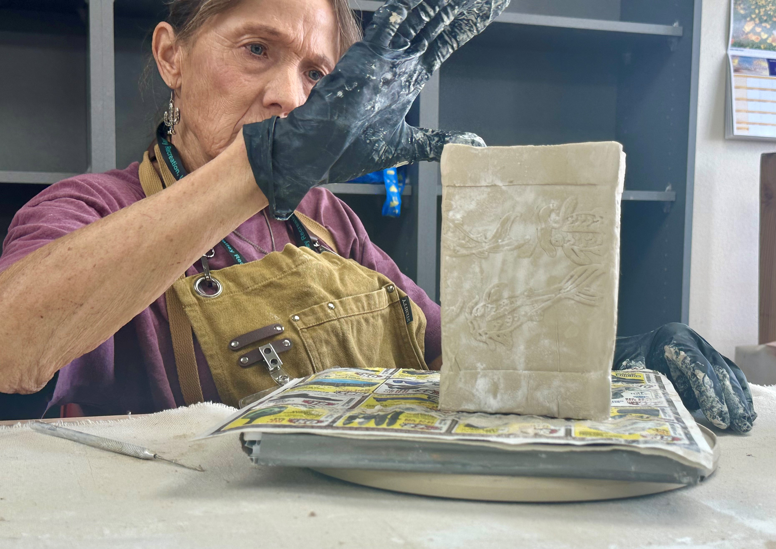
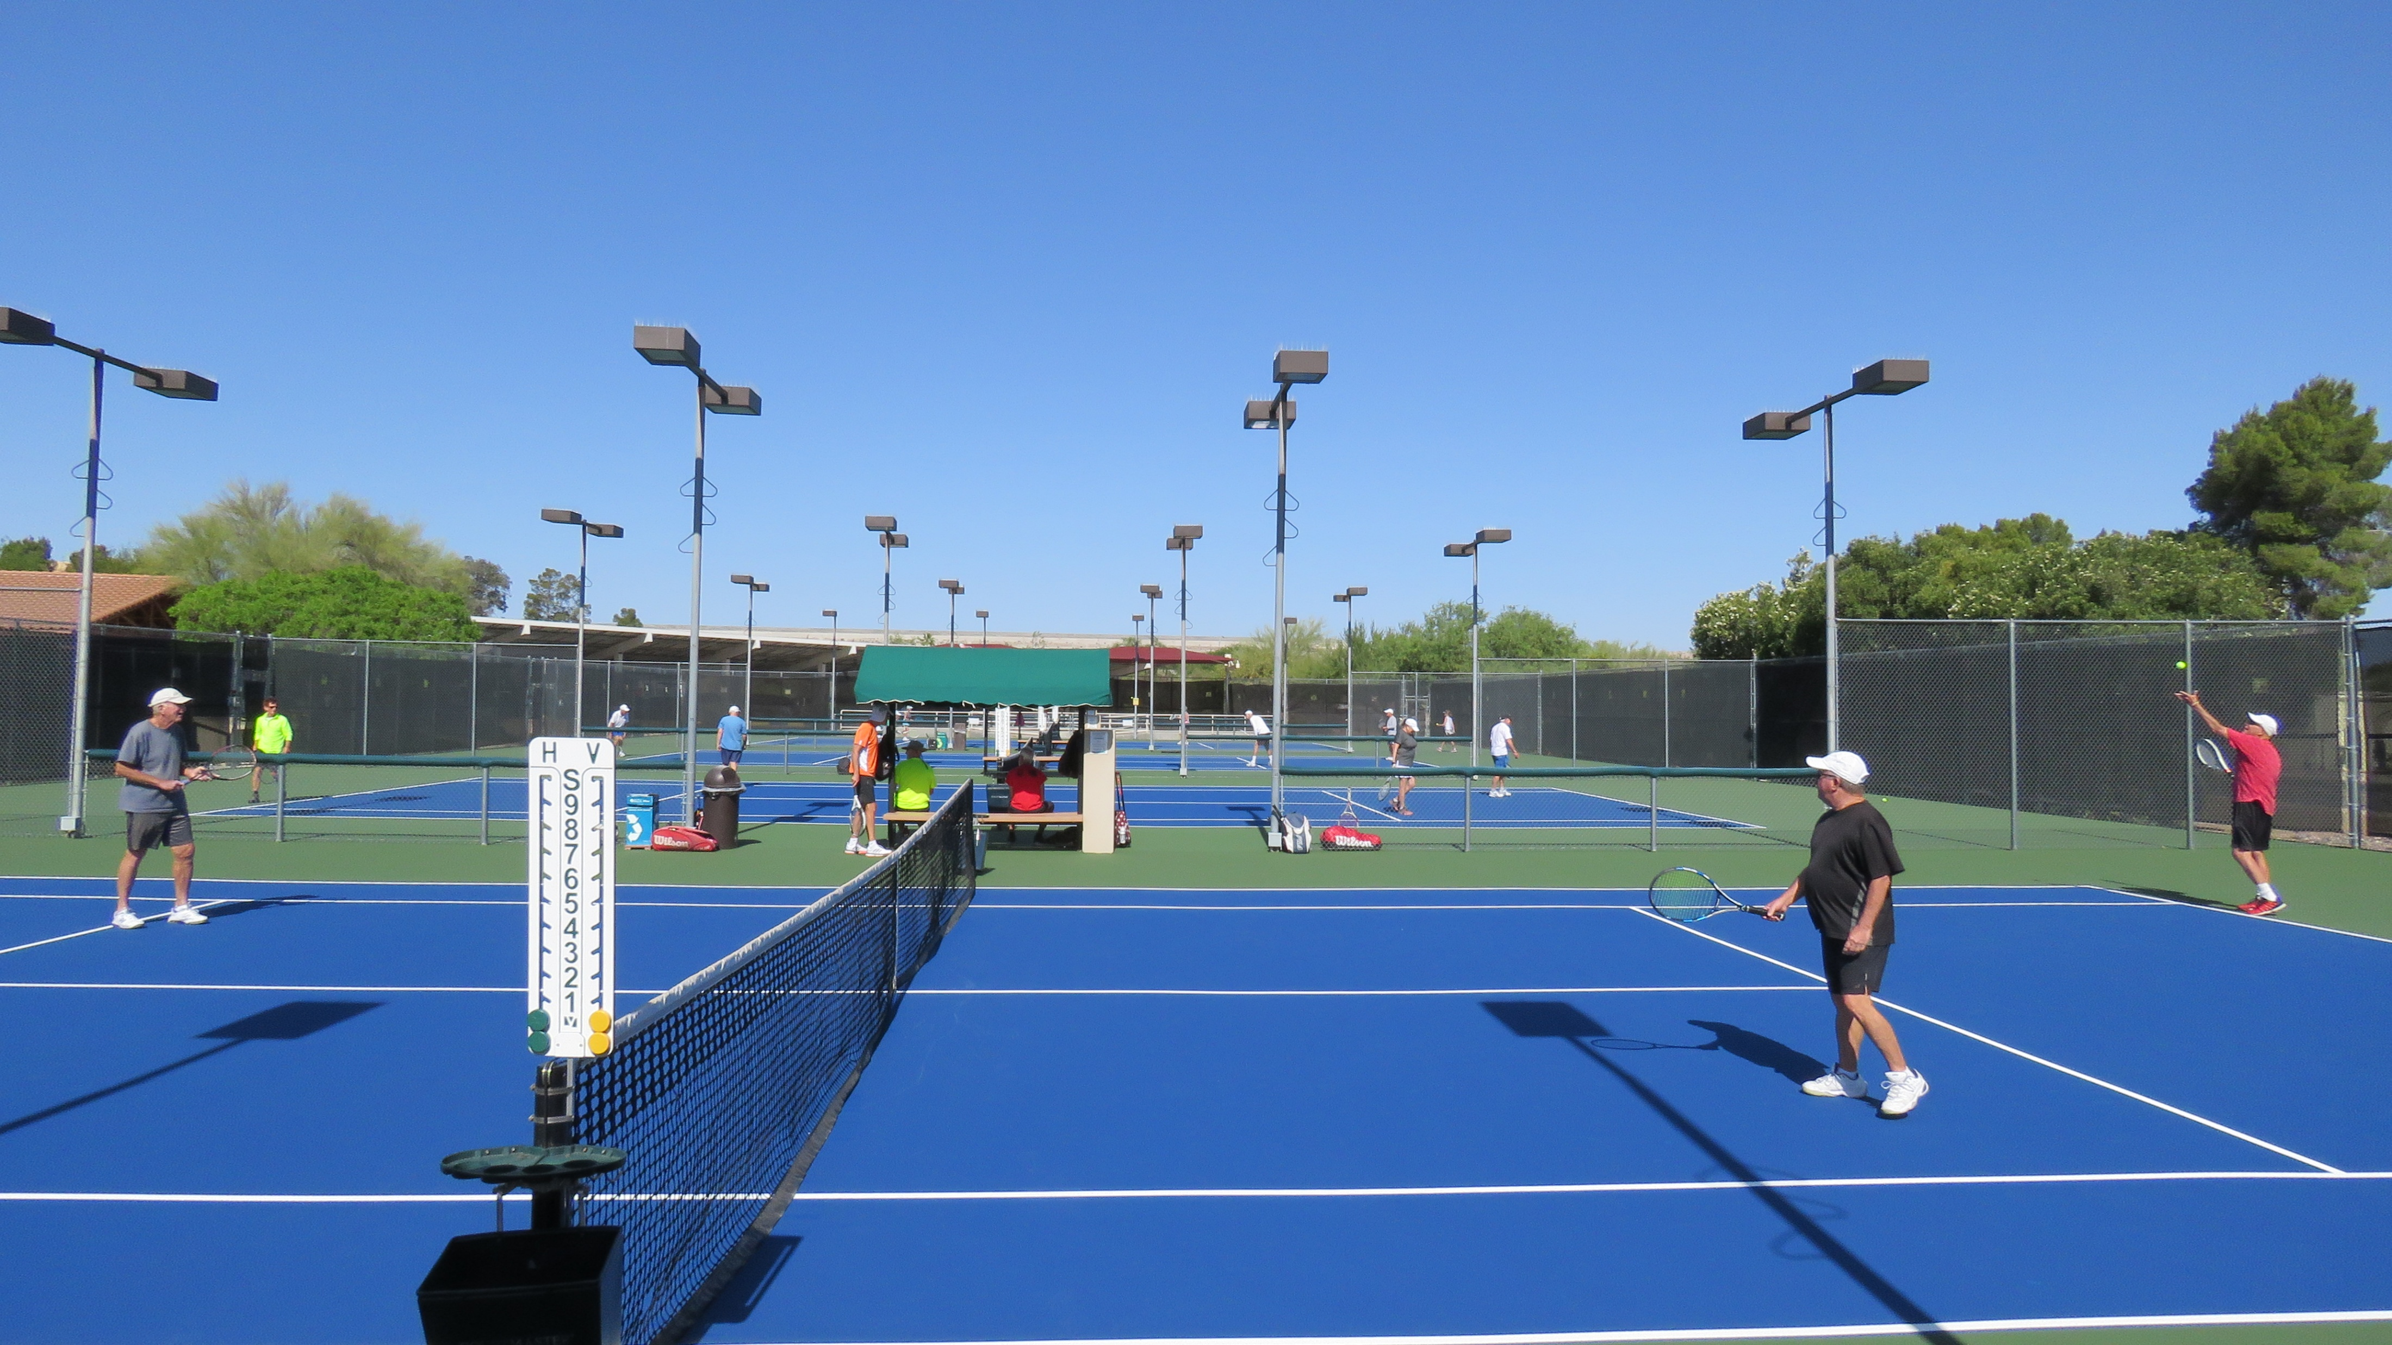
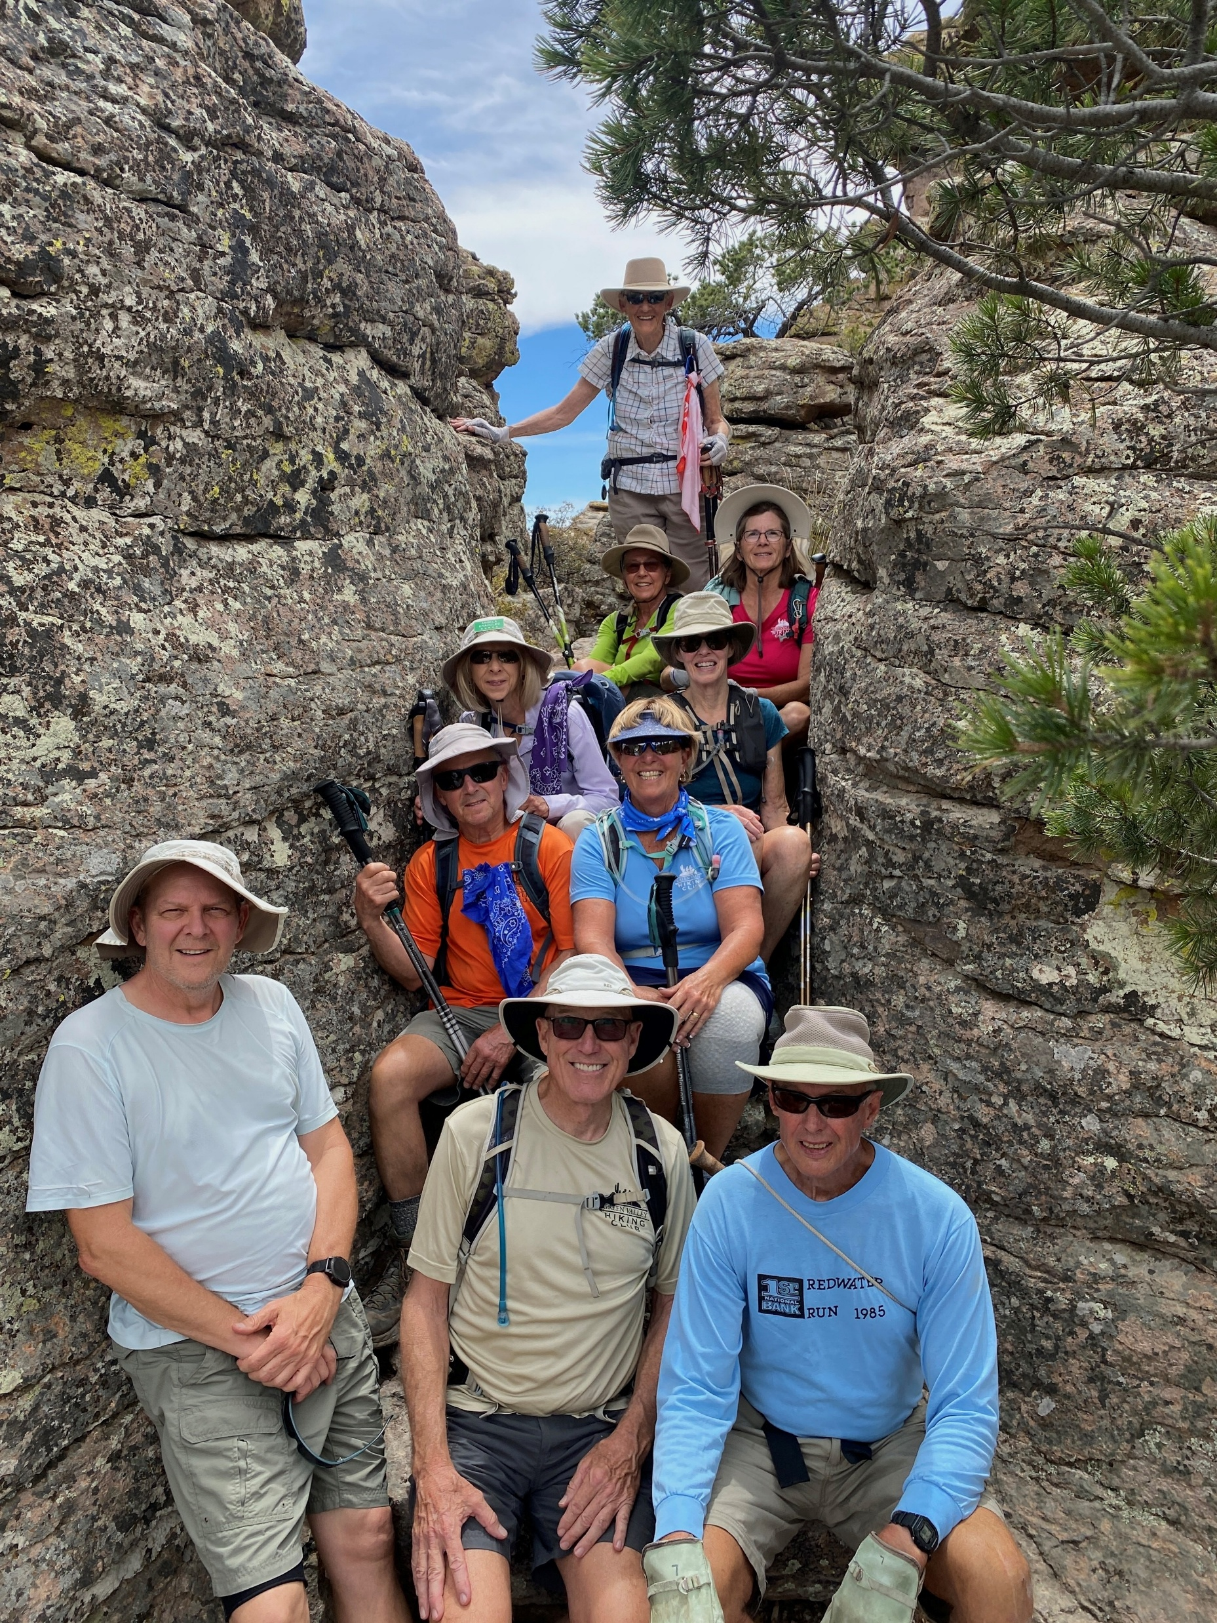

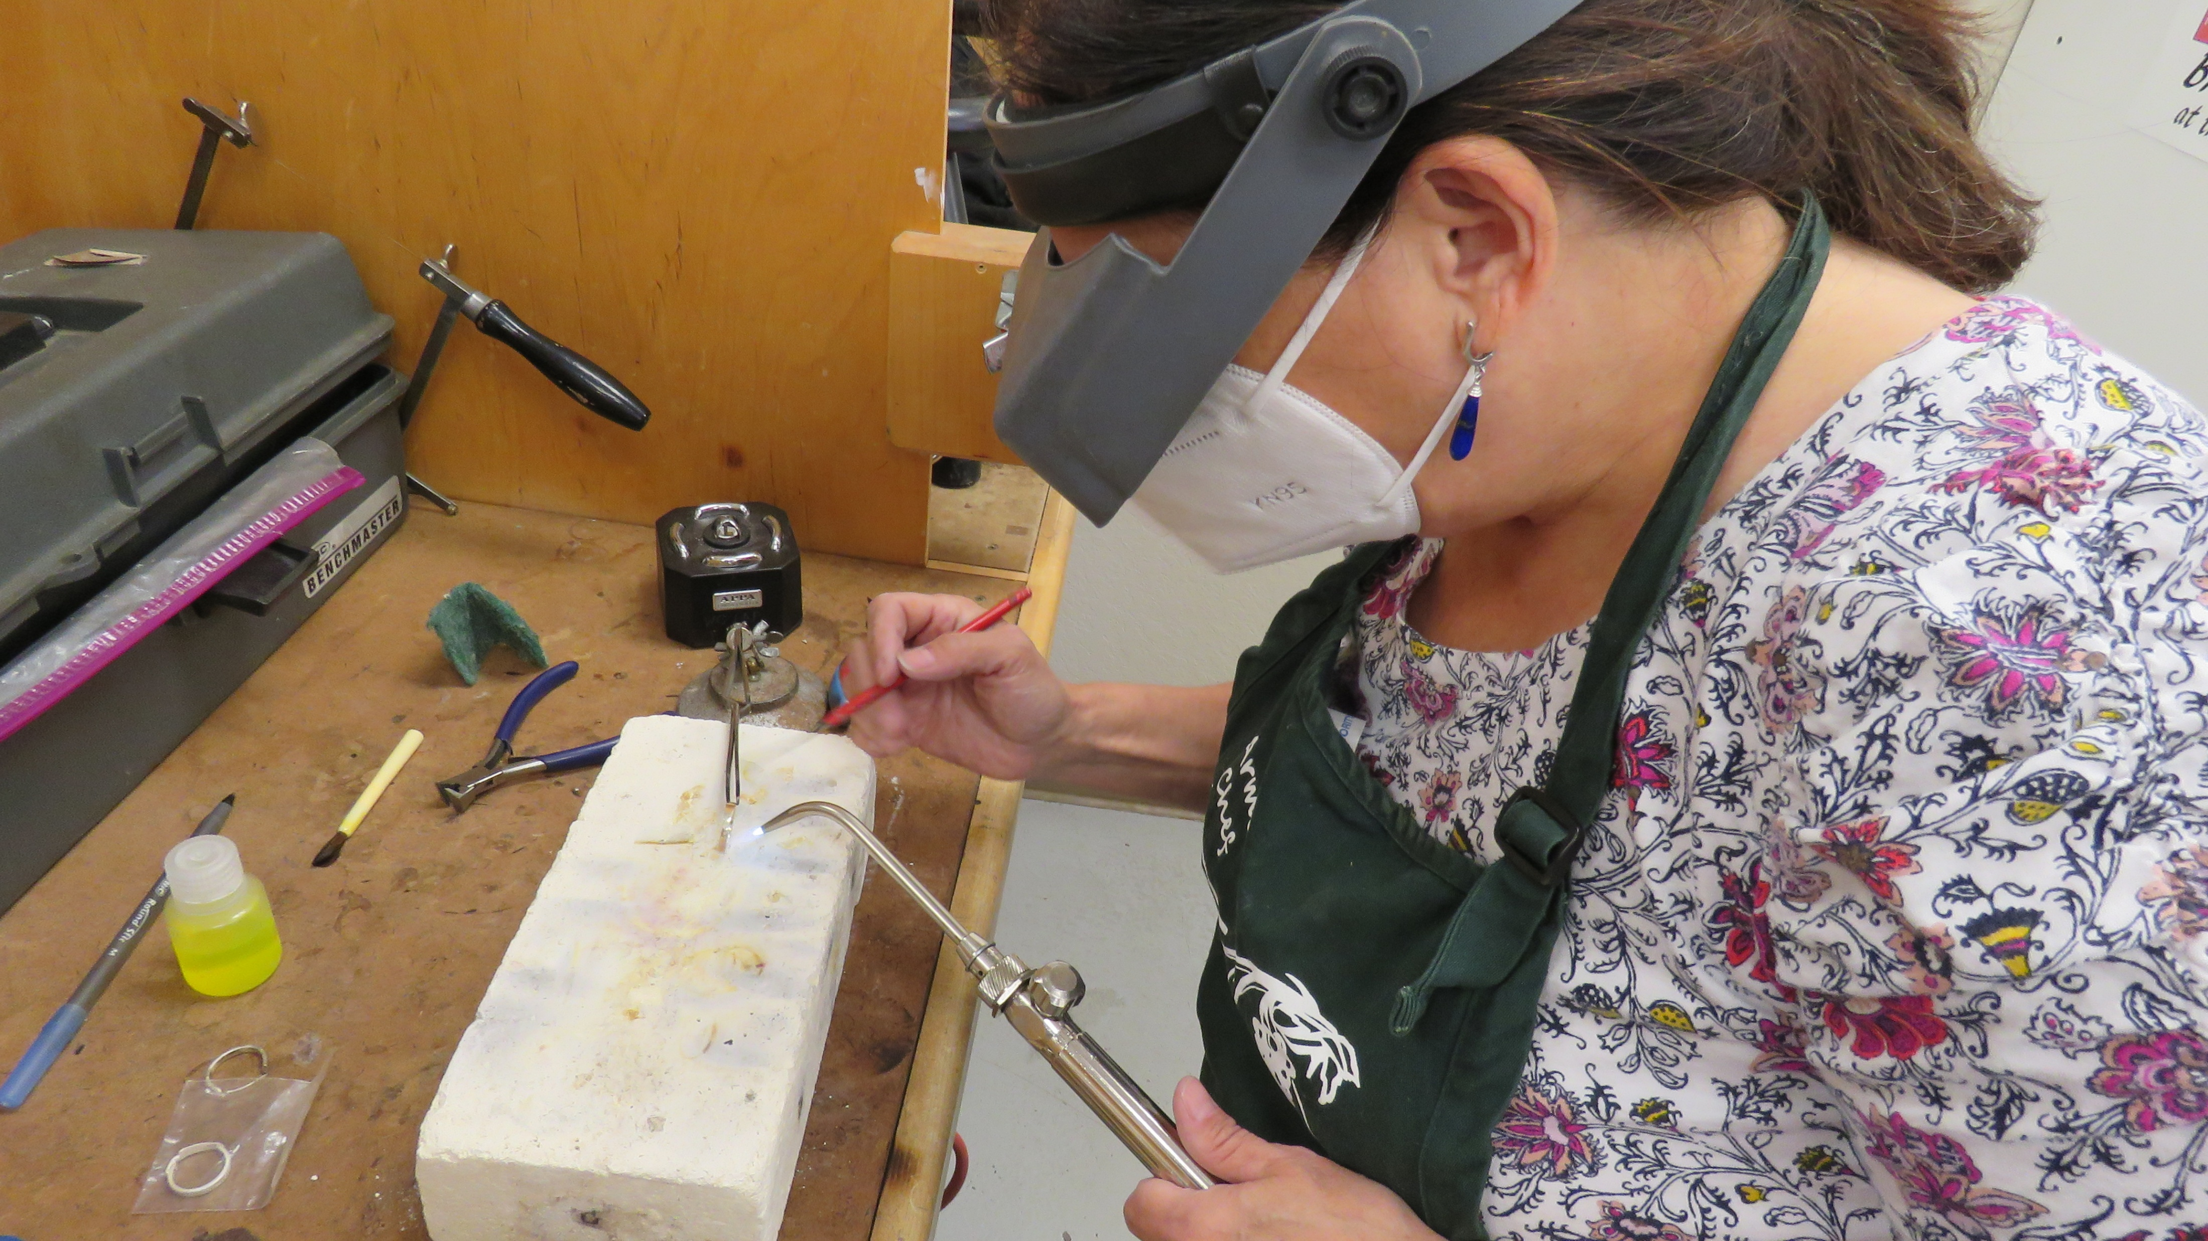
2024 Snapshot of GVR
GVR by the Numbers
GVR’s Most Popular Clubs
Number Six: Clay Studio, 410 Members
Number Seven: Tennis, 393 Members
Number Eight: Hiking, 362 Members
Number Nine: Meditation, 340 Members
Number Ten: Lapidary, 292 Members
Notes:
Six: Clay Studio, increased by 89 members; Seven: Tennis, decreased by 15 members; Eight: Hiking, increased by 9 members; Nine: Meditation, increased by 34 members; Ten: Lapidary, decreased by 8 members. Forum was at number 6 for the 2024 report; replaced at number 10 by Lapidary.

Slide 25
2024 Snapshot of GVR
GVR by the Numbers
Clubs
15
Sports Clubs
2,932 members 323 more than 2023
12
Arts & Crafts Clubs
2,359 members 407 more than 2023
5
Special Interest Clubs
2,233 members 232 fewer than 2023
Notes:
Organized by number of members. Special Interest Clubs are: Canine, Computer, Forum, Meditation, and Photography.

Slide 26
2024 Snapshot of GVR
GVR by the Numbers
Clubs
9
Social Clubs
1,540 members 218 more than 2023
13
Cards & Games Clubs
955 members 46 fewer than 2023
3
Dance Clubs
333 members 29 more than 2023
Notes:
Organized by number of members.

Slide 27
2024 Snapshot of GVR
GVR by the Numbers
Leisure Education
821
Courses Offered
222 more than 2023
7,836
Enrollments
798 more than 2023
183
Full Courses
12 more than 2023

Slide 28
Fitness
6
Fitness Centers
230
Pieces of Large Fitness Equipment
March 28 at 6pm

Slide 29
2024 Snapshot of GVR
GVR by the Numbers
Fitness
10
Personal Trainers
Twice as many as 2023
3-4
Response Time in Days
Response time in 2023 was 30 days
11
Fitness Offerings
Nine more than 2023
Notes:
Response time in days refers to response to equipment issues dependent on availability of parts (back orders and/or supplies). 3-4 days is the response time since July 2024.

Slide 30
2024 Accomplishments

Slide 31

Completed Del Sol Clubhouse renovation
Secured a café vendor

Slide 32
Completed Canoa Hills improvements
Expanded capacity of Desert Hills Auditorium

Slide 33
Finished walking track at Canoa Hills
Created new user-friendly website

Slide 34
Made headway on:
Lapidary expansion
Artisans’ Shop expansion
Woodshop expansion

Slide 35
Updated Finance and Capital Improvement Policies
Included three-year forecasting in Annual Budget

Slide 36
Received a successful audit with no findings or recommendations

Slide 37
2025 Accomplishment
And then this happened…

Slide 38
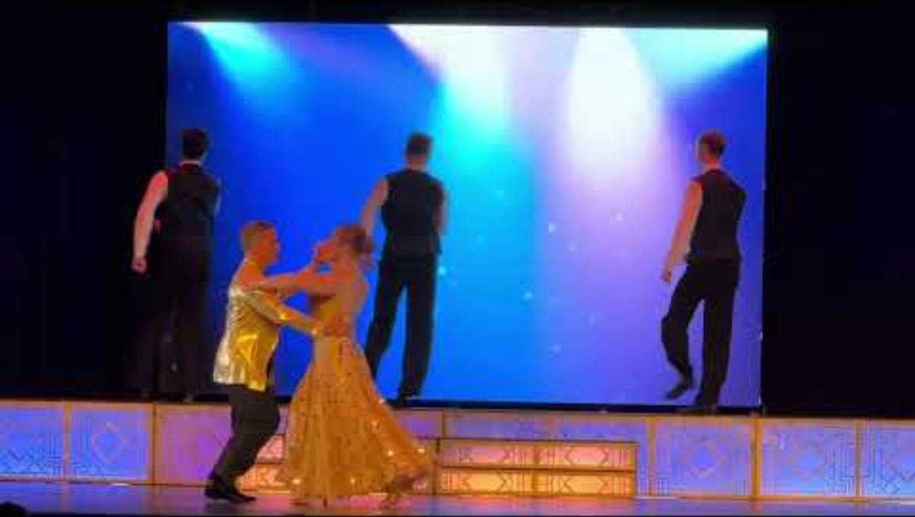
2025 Accomplishment

Slide 39
2025 Goals and
Projects

Slide 40
2025 Goals and Projects
Complete Desert Hills Locker Room Improvements
Complete Ceramics Club Kiln Room Improvements

Slide 41
Complete Metal Working Crafts Club Improvements
Complete Artisans’ Shop Improvements

Slide 42
Begin Lapidary Club
expansion project
Updates to several centers including restrooms in the Desert Hills lobby and flooring at Las Campanas

Slide 43
Develop recommendations to improve Board appointed committees
and member
appointment process

Slide 44
Complete utilities efficiency audit
Explore revenue diversification options

Slide 45
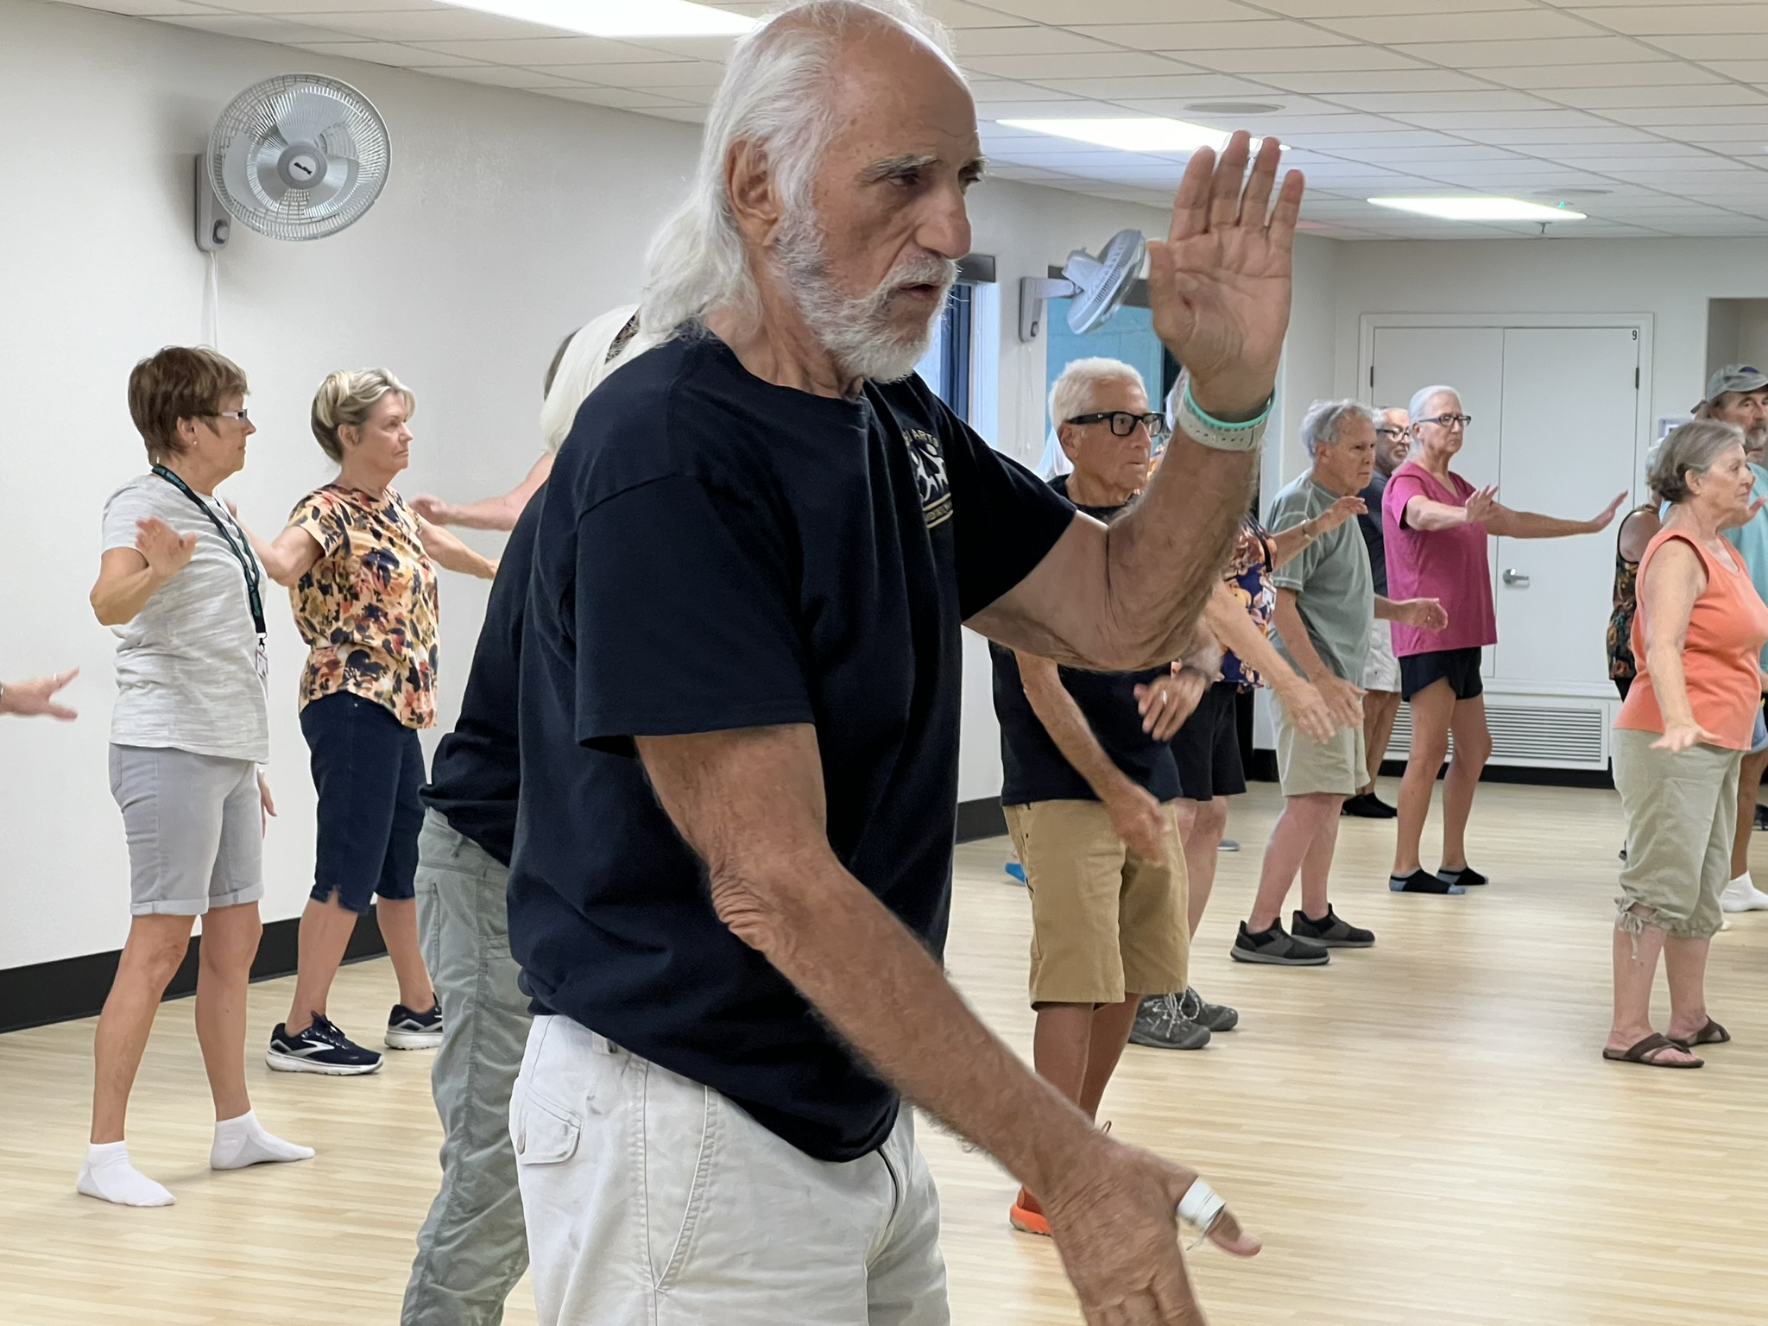
Thank you!

