Slide 1
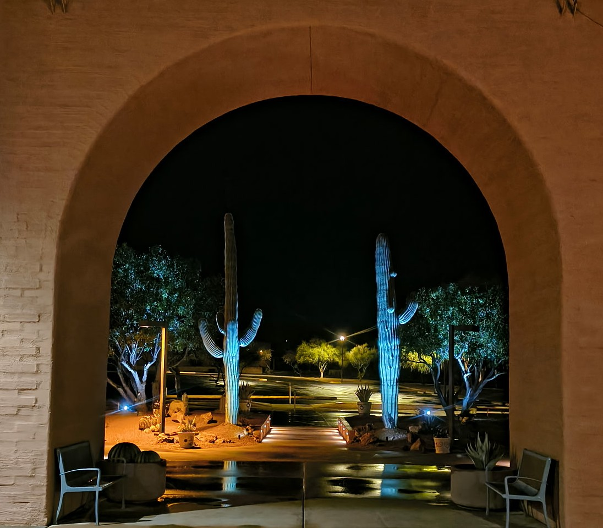

2025 Year in Review
Annual Meeting
2026

Slide 2
GVR’s Mission
To provide excellent facilities and services that create opportunities for recreation, social activities, and leisure education to enhance the quality of our members’ lives.

Slide 3
2025 Year In Review
2025 Snapshot of GVR
2025 Accomplishments
2026 Goals and Projects

Slide 4
2025 Snapshot of GVR

Slide 5
2025 Snapshot of GVR
13,902
Individual Households
Increase of 30 over 2024
March 28 at 6pm
22,317
Individual Members
Decrease of 18 over 2024
Notes:
**Please note that the Change from Last Year number for Member Households will look to be more than 22. Please report the increase as 22 even though the math does not add up. We are changing the way we report numbers beginning with 2024. (I reviewed this with Barb and she and I decided we would change the reporting method this year.)

Slide 6
2025 Snapshot of GVR
Babies by the Decade
1910S
1920s
1930s
1940s
1950s
1960s
1970s
1980s
1990s
9
195
2150
8122
7010
2234
364
90
131
Most popular birth year: 1947

Slide 7
2025 Snapshot of GVR
1,561
Guest Passes Issued
Increase of 26 over 2024
1,227
Tenant Passes Issued
Increase of 46 over 2024
52
LifeCare Passes Issued
Decrease of 35 since 2024

Slide 8
2025 Snapshot of GVR
Centers
7
Major Centers
8
Satellite Centers

Slide 9
2025 Snapshot of GVR
Centers
176,283
Square Feet
57
Acres6pm
Notes:
West center acreage includes the AO and metal shop yard.

Slide 10
2025 Snapshot of GVR
Pools & Spas
24
Pools & Spas
1,128,285
Gallons of Water

Slide 11
2025 Snapshot of GVR
Governance
13
Board Directors Served
37
Committee Members Served

Slide 12
2025 Snapshot of GVR
Governance
64
Hours served in
Board Meetings
85.5
Hours served on Board Committees
Notes:
Hours served in Board Meetings = 31 Meeting Hours x 12 directors = 372. Hours served on Board Committees = The total of six Board Committees, the members of those Committees x Meeting Hours = 372.5.

Slide 13
2025 Snapshot of GVR
Staff
79.5
Full-Time Staff
11.4
Part-Time Staff
March 28 at 6pm
90.9
Total
March 28 at 6pm

Slide 14
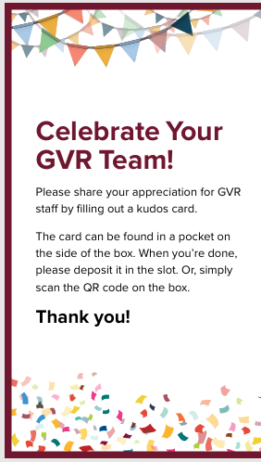
2025 Snapshot of GVR
Staff
As part of GVR’s focus on employee recognition, GVR launched “Celebrate Your GVR Staff” boards across the centers in 2025 where members are invited to leave short notes thanking staff for great service or support.
The boards generate approximately a dozen messages each week, and these recognitions are shared with employees to highlight the difference they make for members.
at 6pm

Slide 15
2025 Snapshot of GVR
GVR by the Numbers
Events and Entertainment
11,013
Total Audience
Increase of 63% over 2024
March 28 at 6pm
121
Total Events
Increase of 86% over 2024

Slide 16
2025 Snapshot of GVR
GVR by the Numbers
SOLD OUT
Events and Entertainment
9
Events
March 28 at 6pm
14
Day Trips

Slide 17
2025 Snapshot of GVR
GVR by the Numbers
Events and Entertainment
141
Volunteers
Increase of 22% over 2024
March 28 at 6pm
New Offerings Include:
NASCAR, NFL, and Mesa Marketplace day trips; Nogales Taco Tours; Lunch and a Movie; Events’ beverage and food service; Free Karaoke and game nights

Slide 18
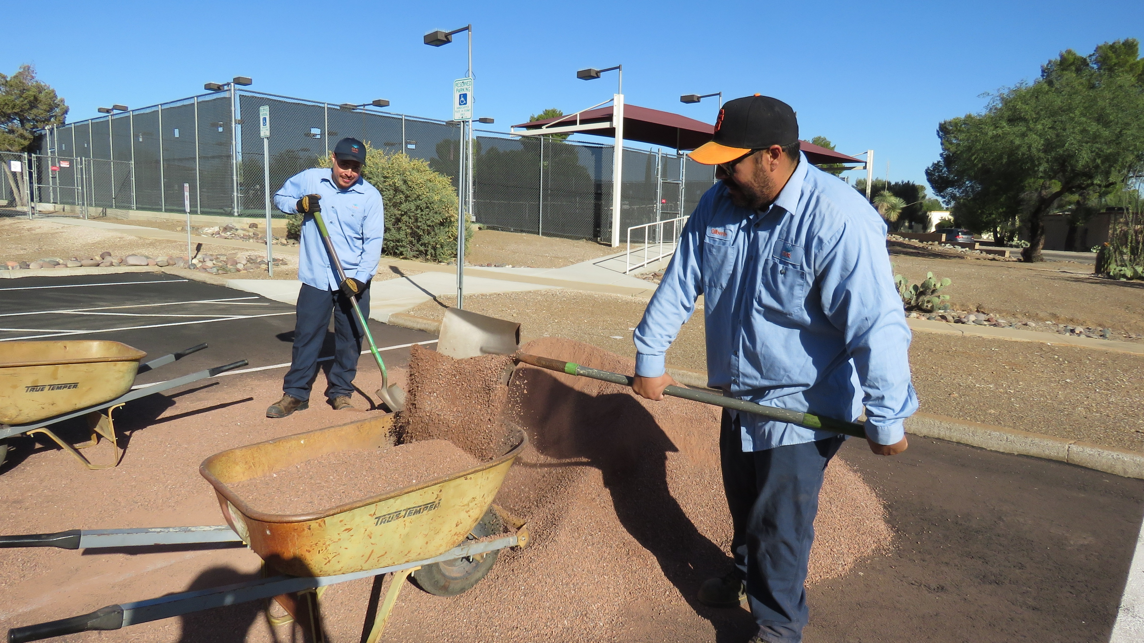
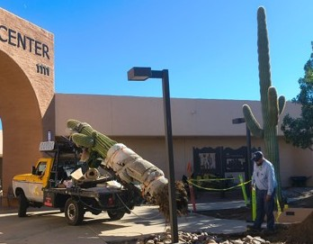
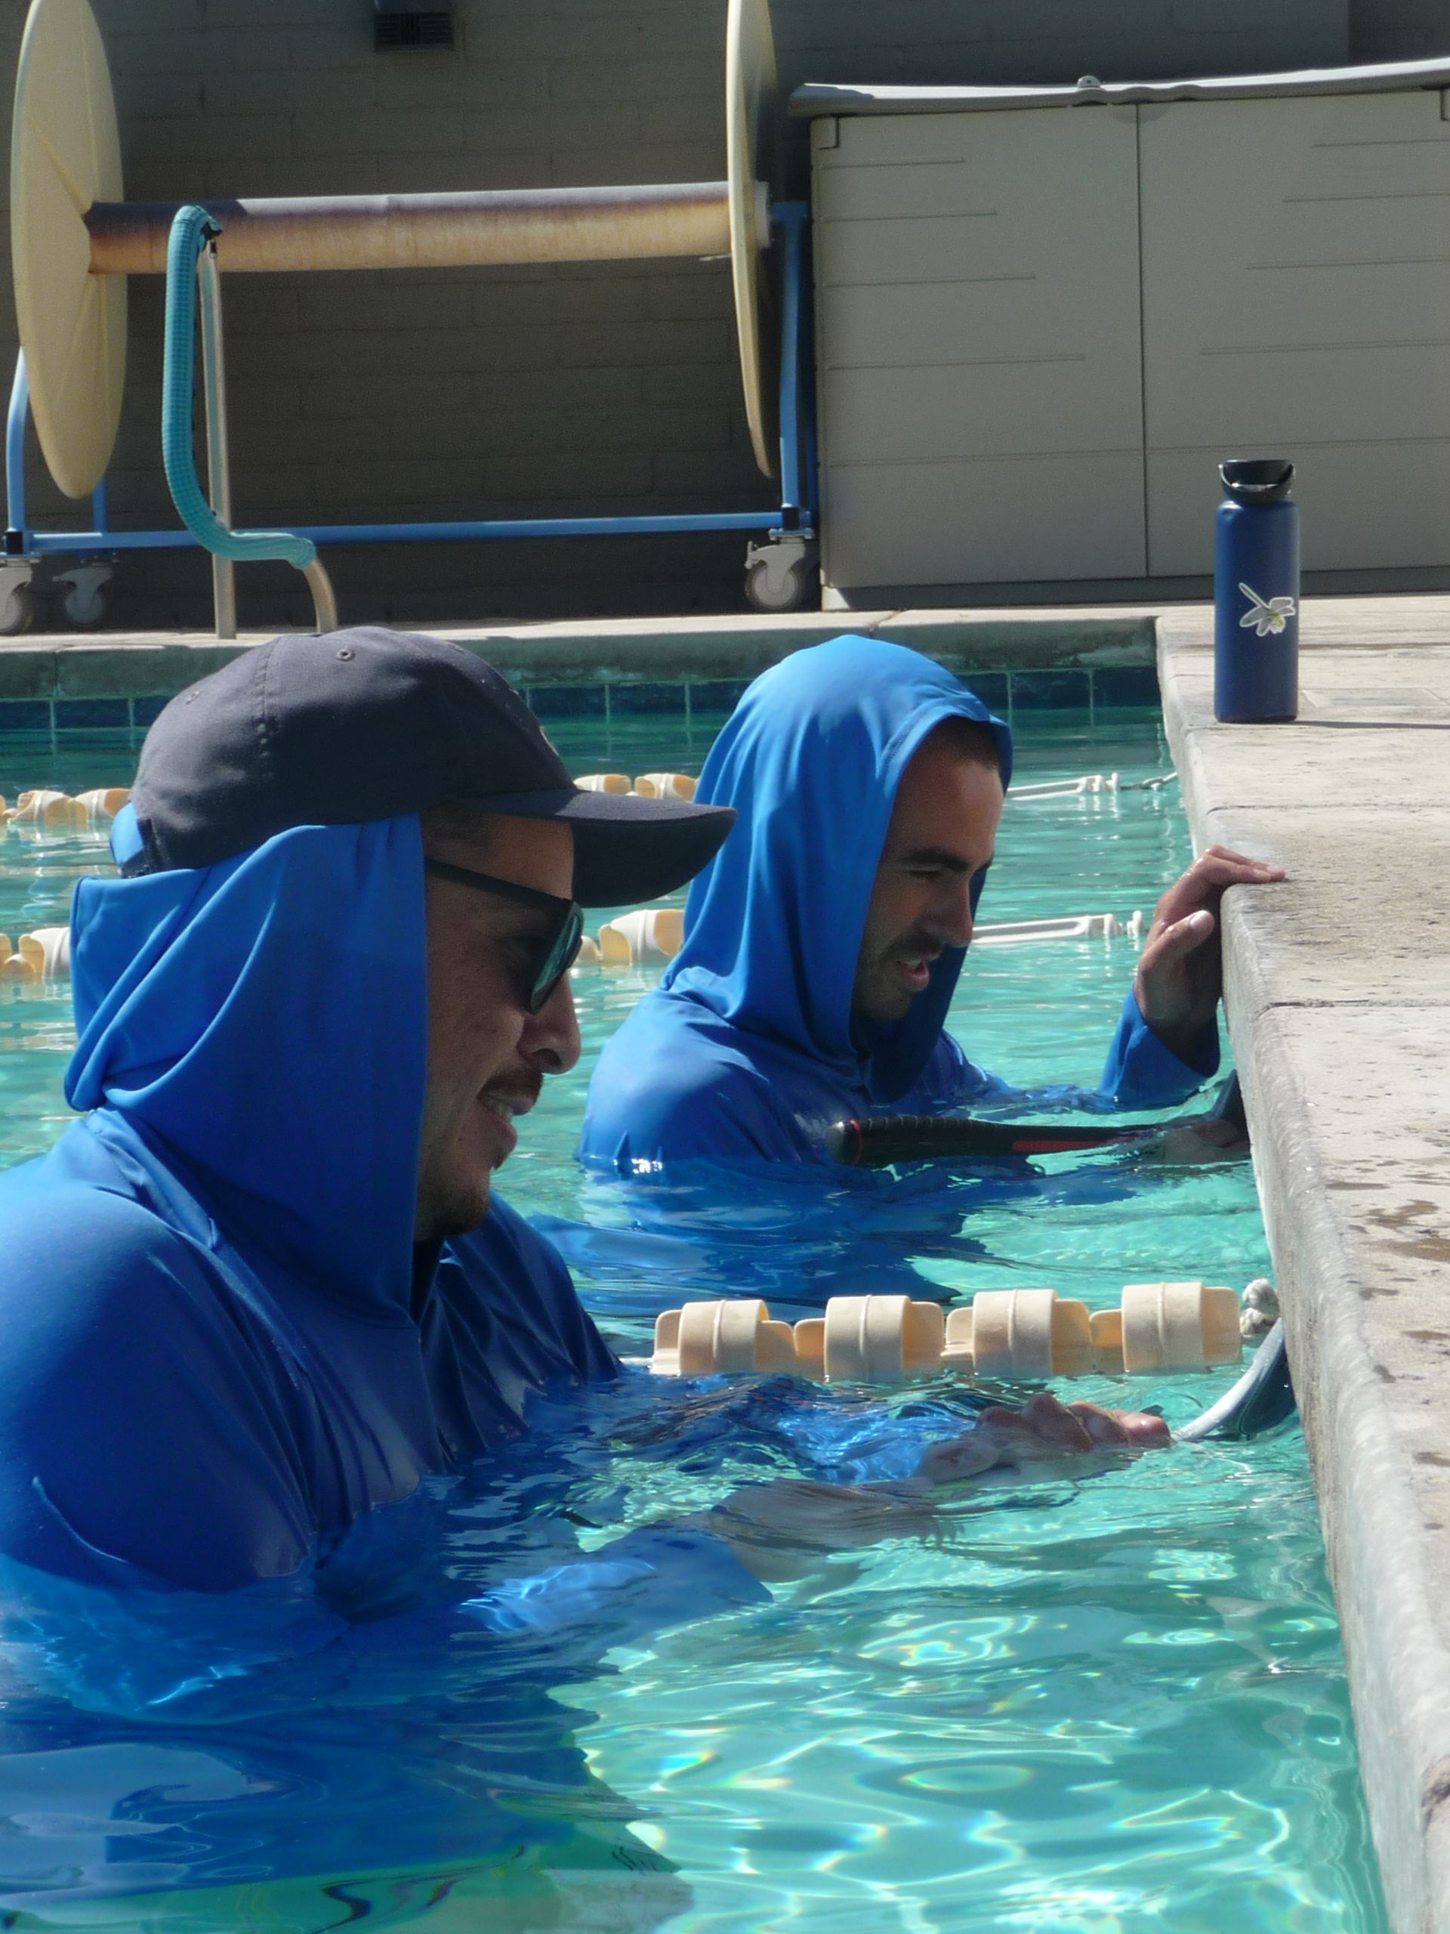
2025 Snapshot of GVR
GVR by the Numbers
Facilities Maintenance
5089
Completed Work Orders
Increase of 21% over 2024

Slide 19
2025 Snapshot of GVR
GVR by the Numbers
Clubs
55
Clubs
Two disbanded:
Hearts and Decorative Arts
10,517
Club Members
165 more than 2024
Notes:
GVR Valley Players Club provided live theater performances. GVR Travel Club dissolved 1/31/2025 (So, they were in the process of dissolving at the end of 2024 but not yet dissolved.)

Slide 20
2025 Snapshot of GVR
GVR by the Numbers
GVR’s Ten Most Popular Clubs

Slide 21

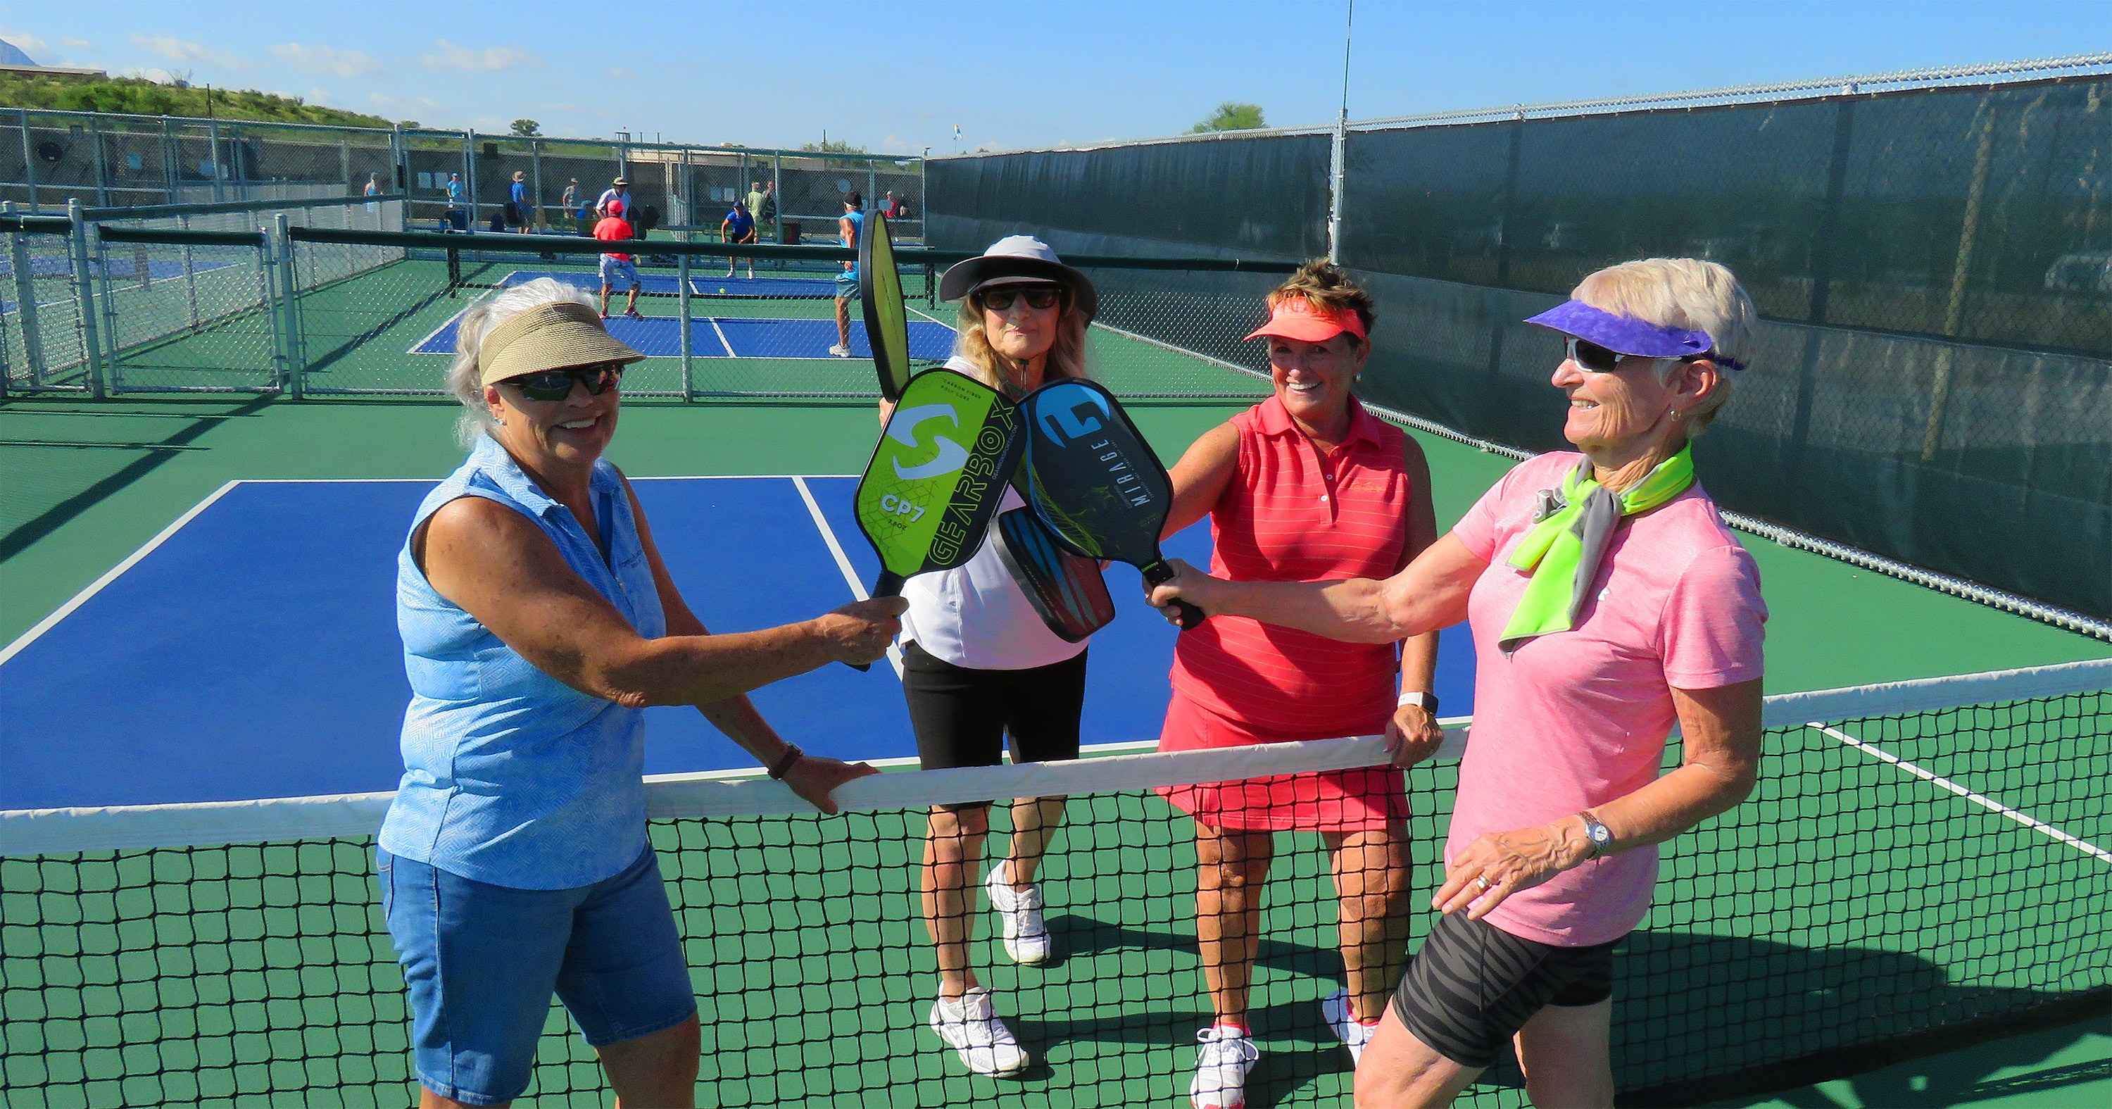
2025 Snapshot of GVR
GVR by the Numbers
Pickleball: 1,230 Members
Decrease of 7 members since 2024

Slide 22

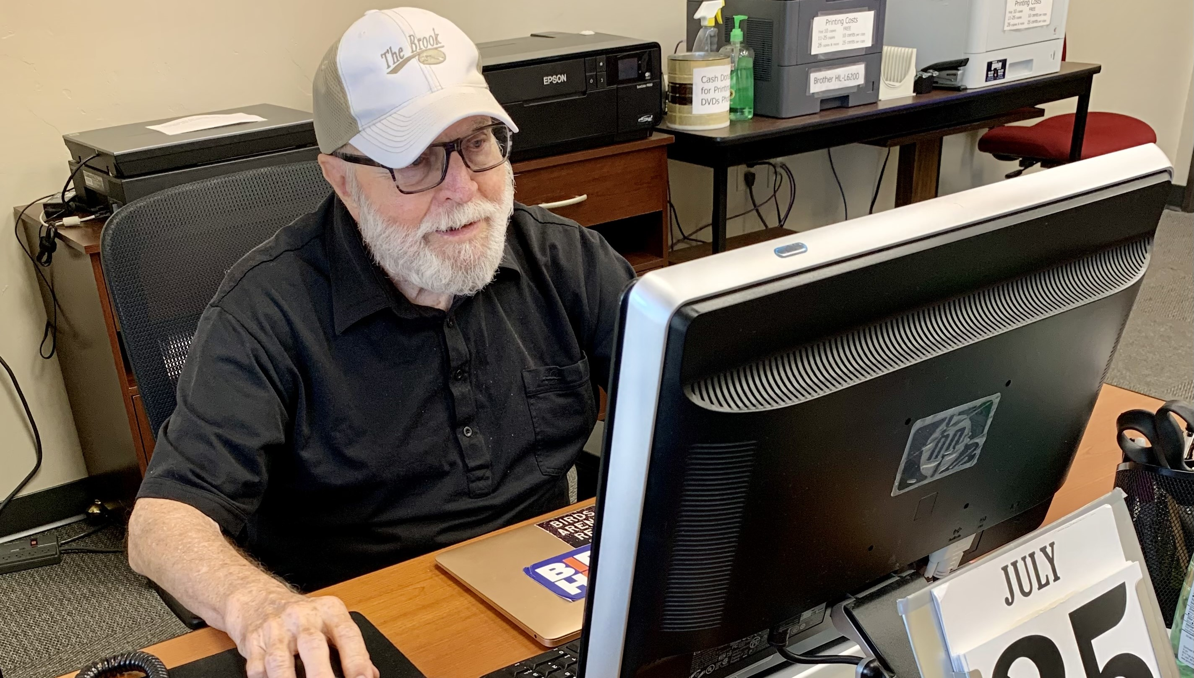
2025 Snapshot of GVR
GVR by the Numbers
Computer: 884 Members
Increase of 87 members since 2024

Slide 23

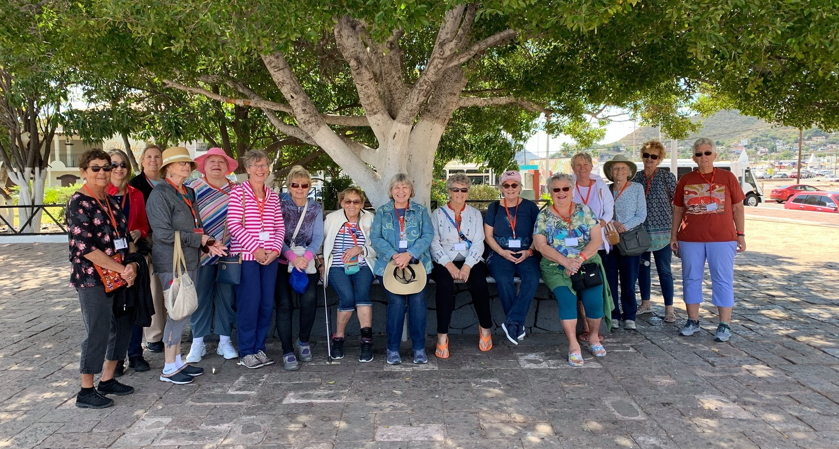
2025 Snapshot of GVR
GVR by the Numbers
Amigas: 712 Members
Increase of 74 members since 2024
Notes:
Amigas were number five last year with 424 members.

Slide 24

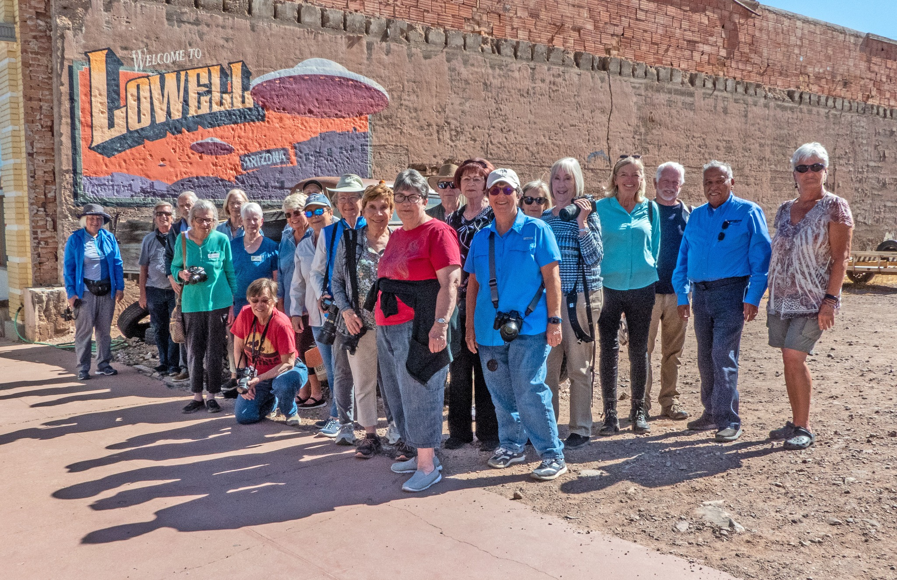
2025 Snapshot of GVR
GVR by the Numbers
Photography: 583 Members
Decrease of 68 members since 2024

Slide 25

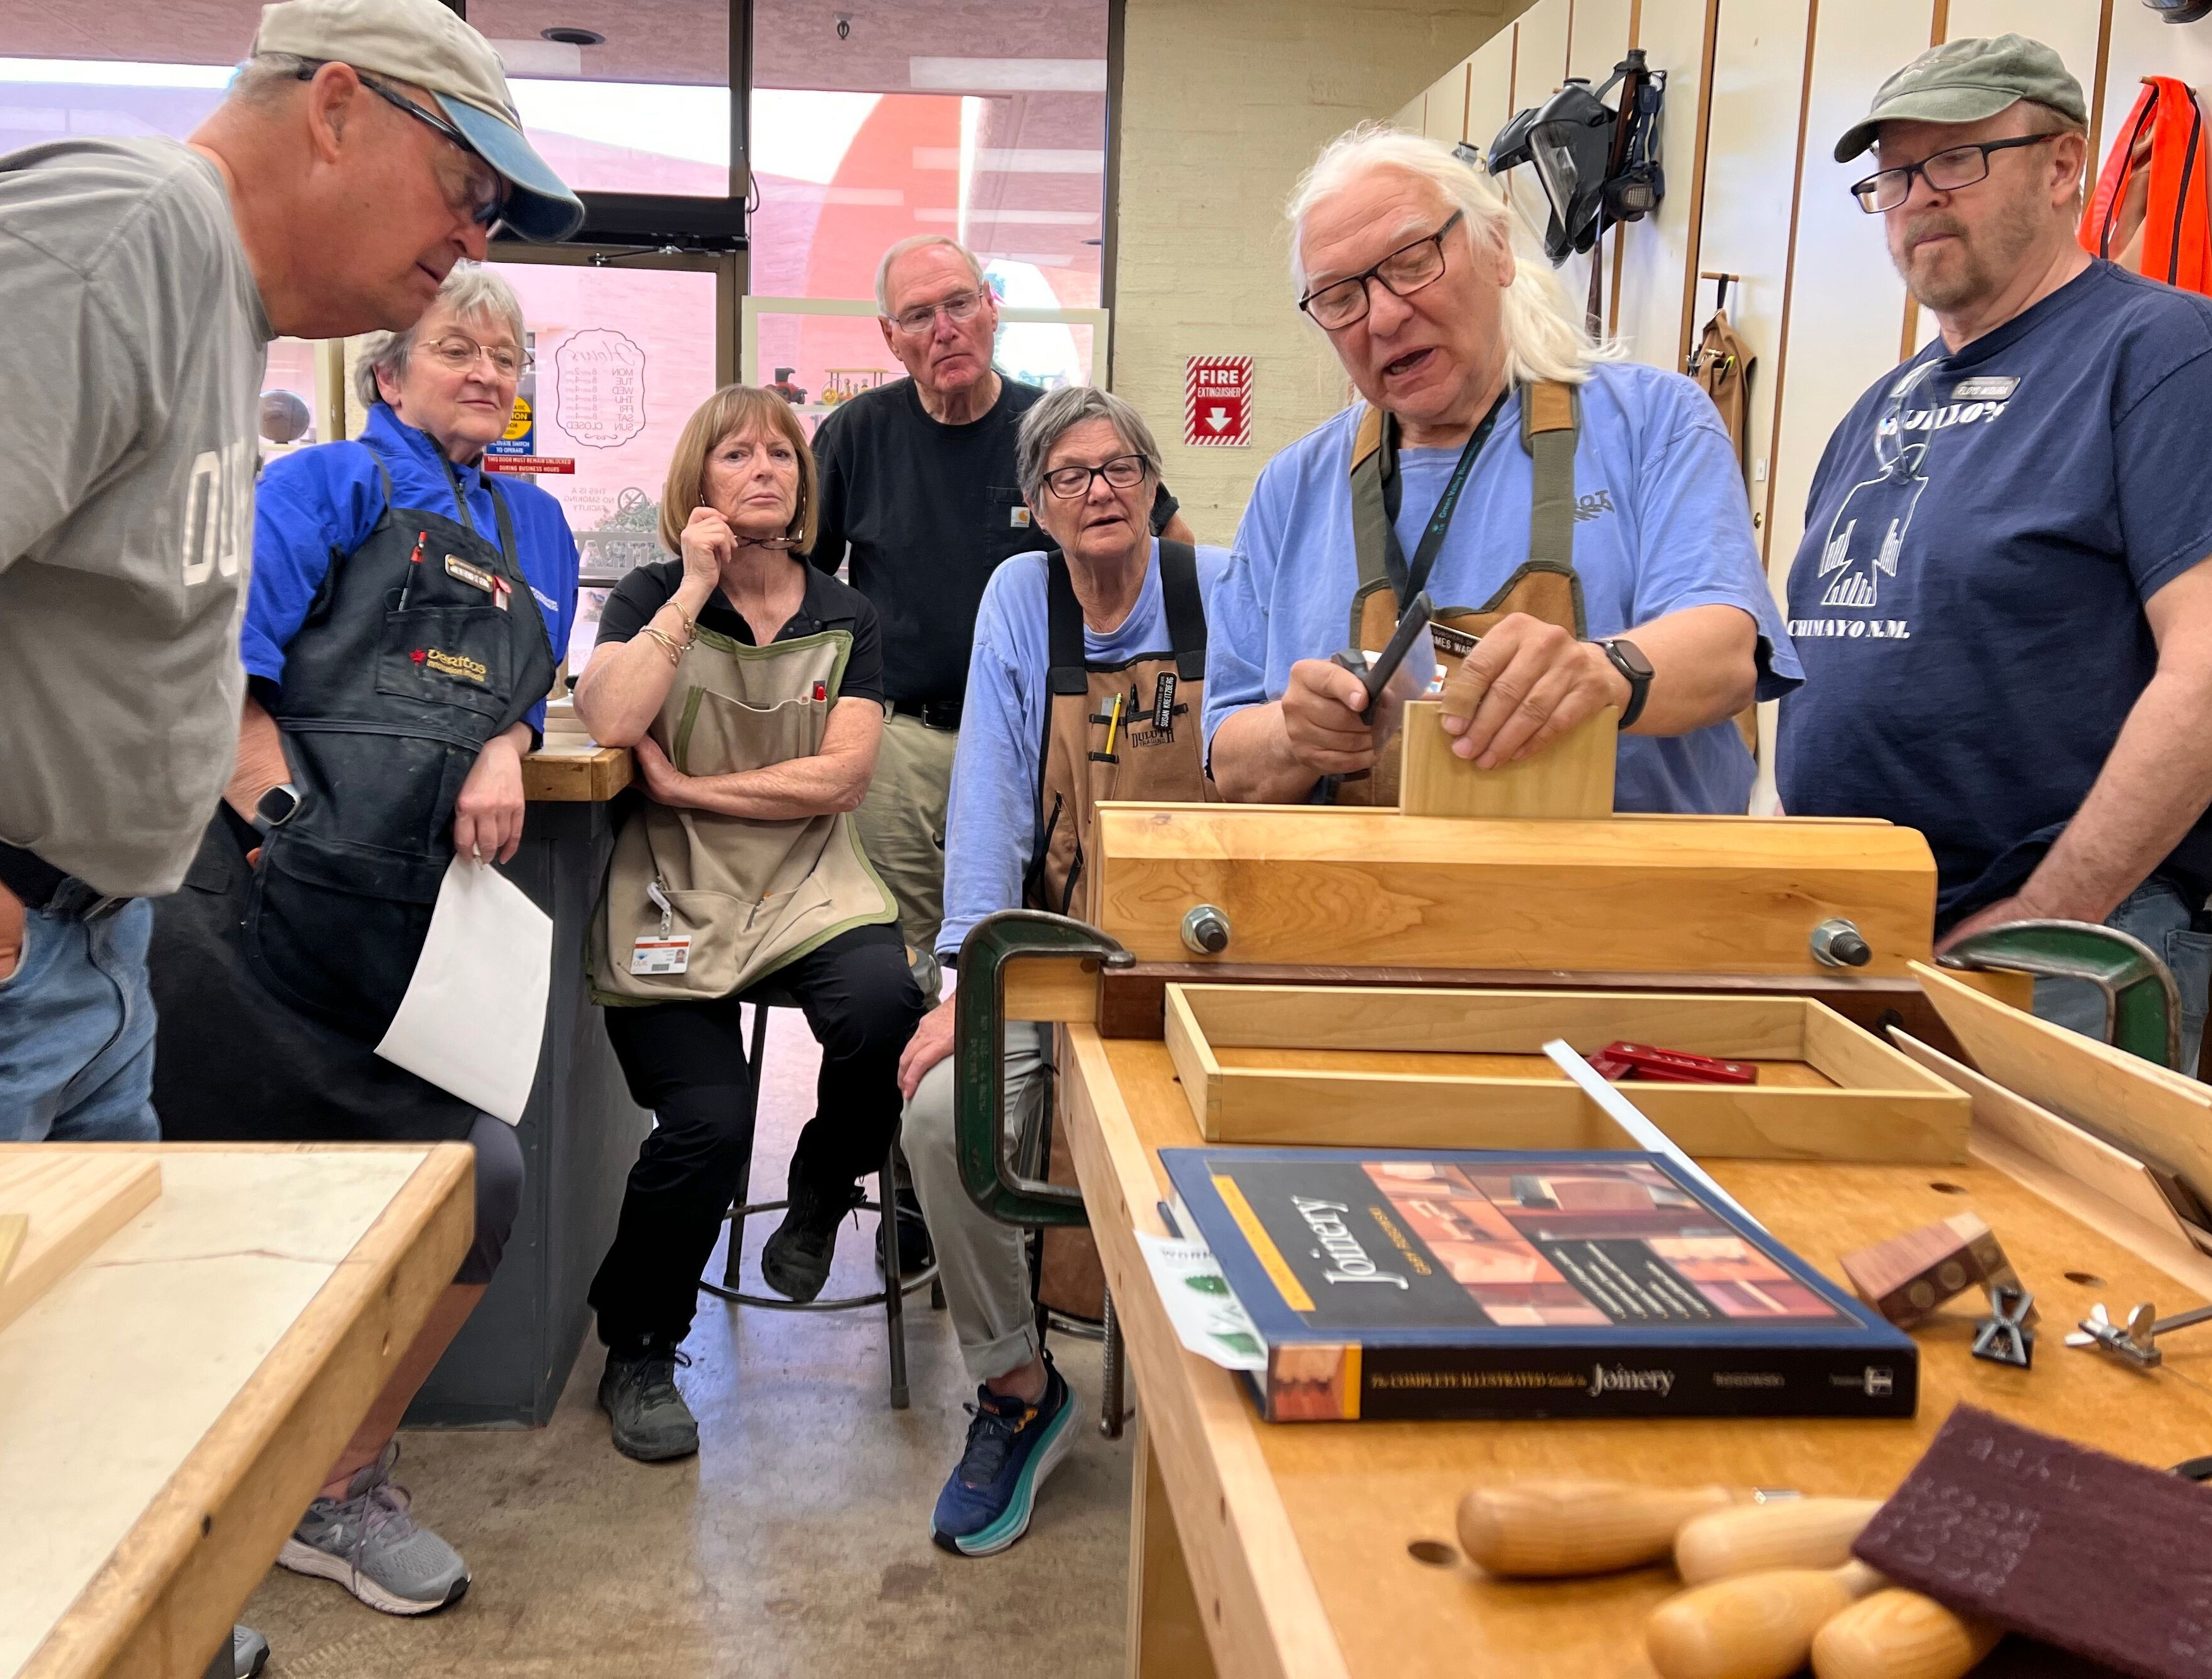
2025 Snapshot of GVR
GVR by the Numbers
Woodworkers: 537 Members
Decrease of 34 members since 2024
Notes:
Woodworkers were number four last year with 468 members. Member number count methodology changed from 2023 to 2024. This is most noticeable with Woodworkers numbers should it come up.

Slide 26
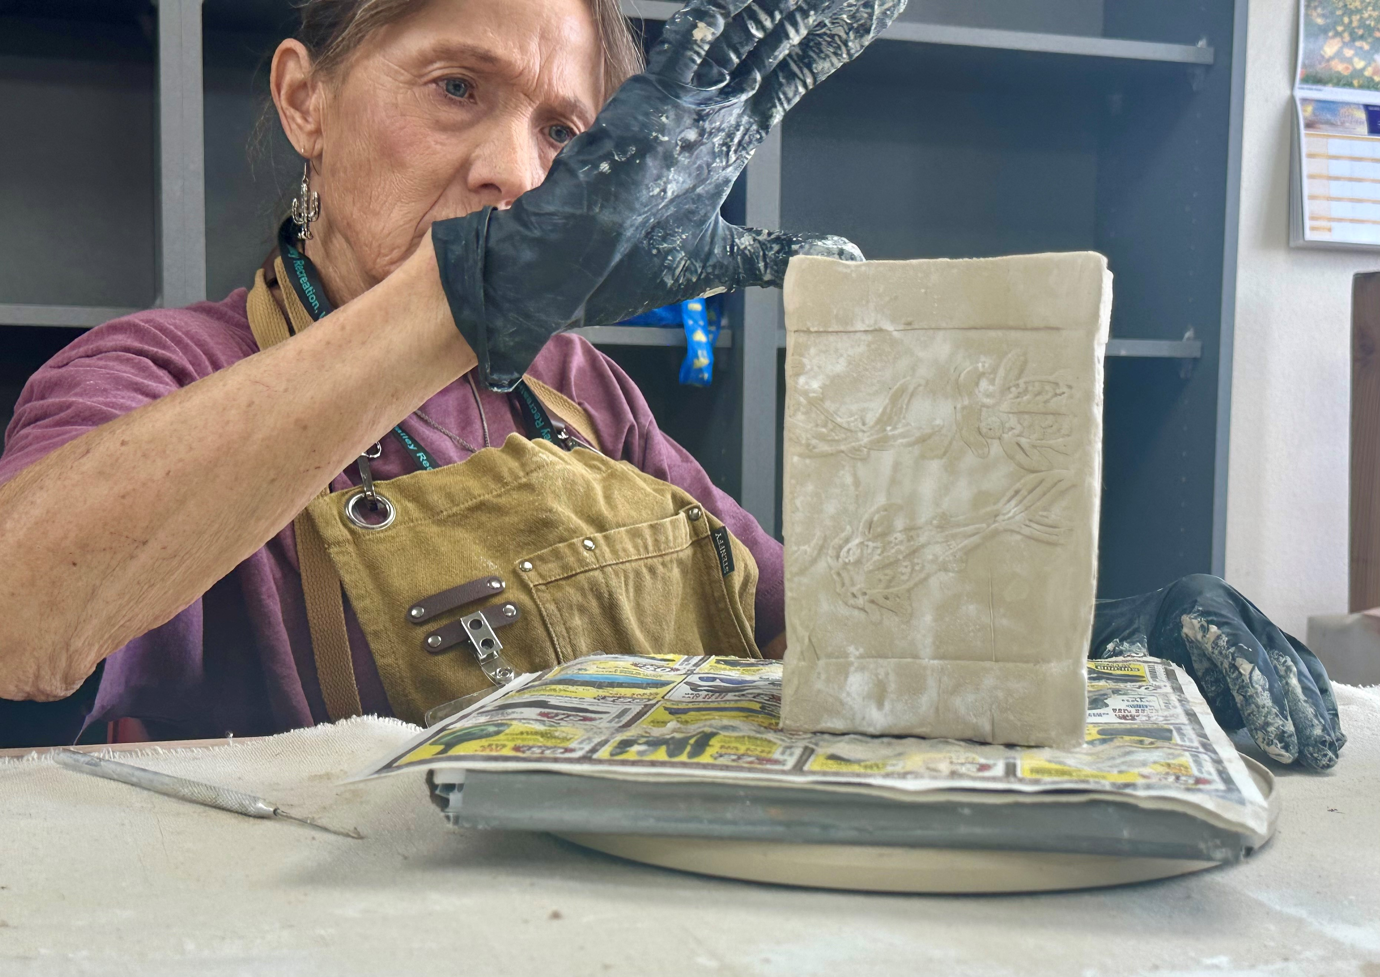
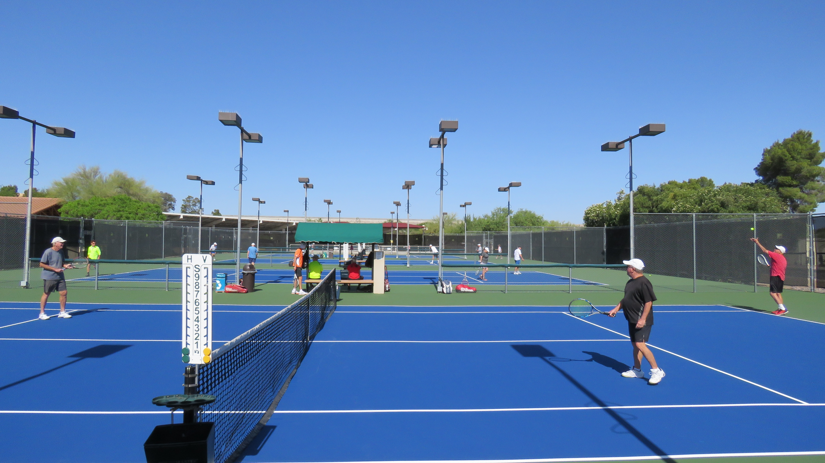
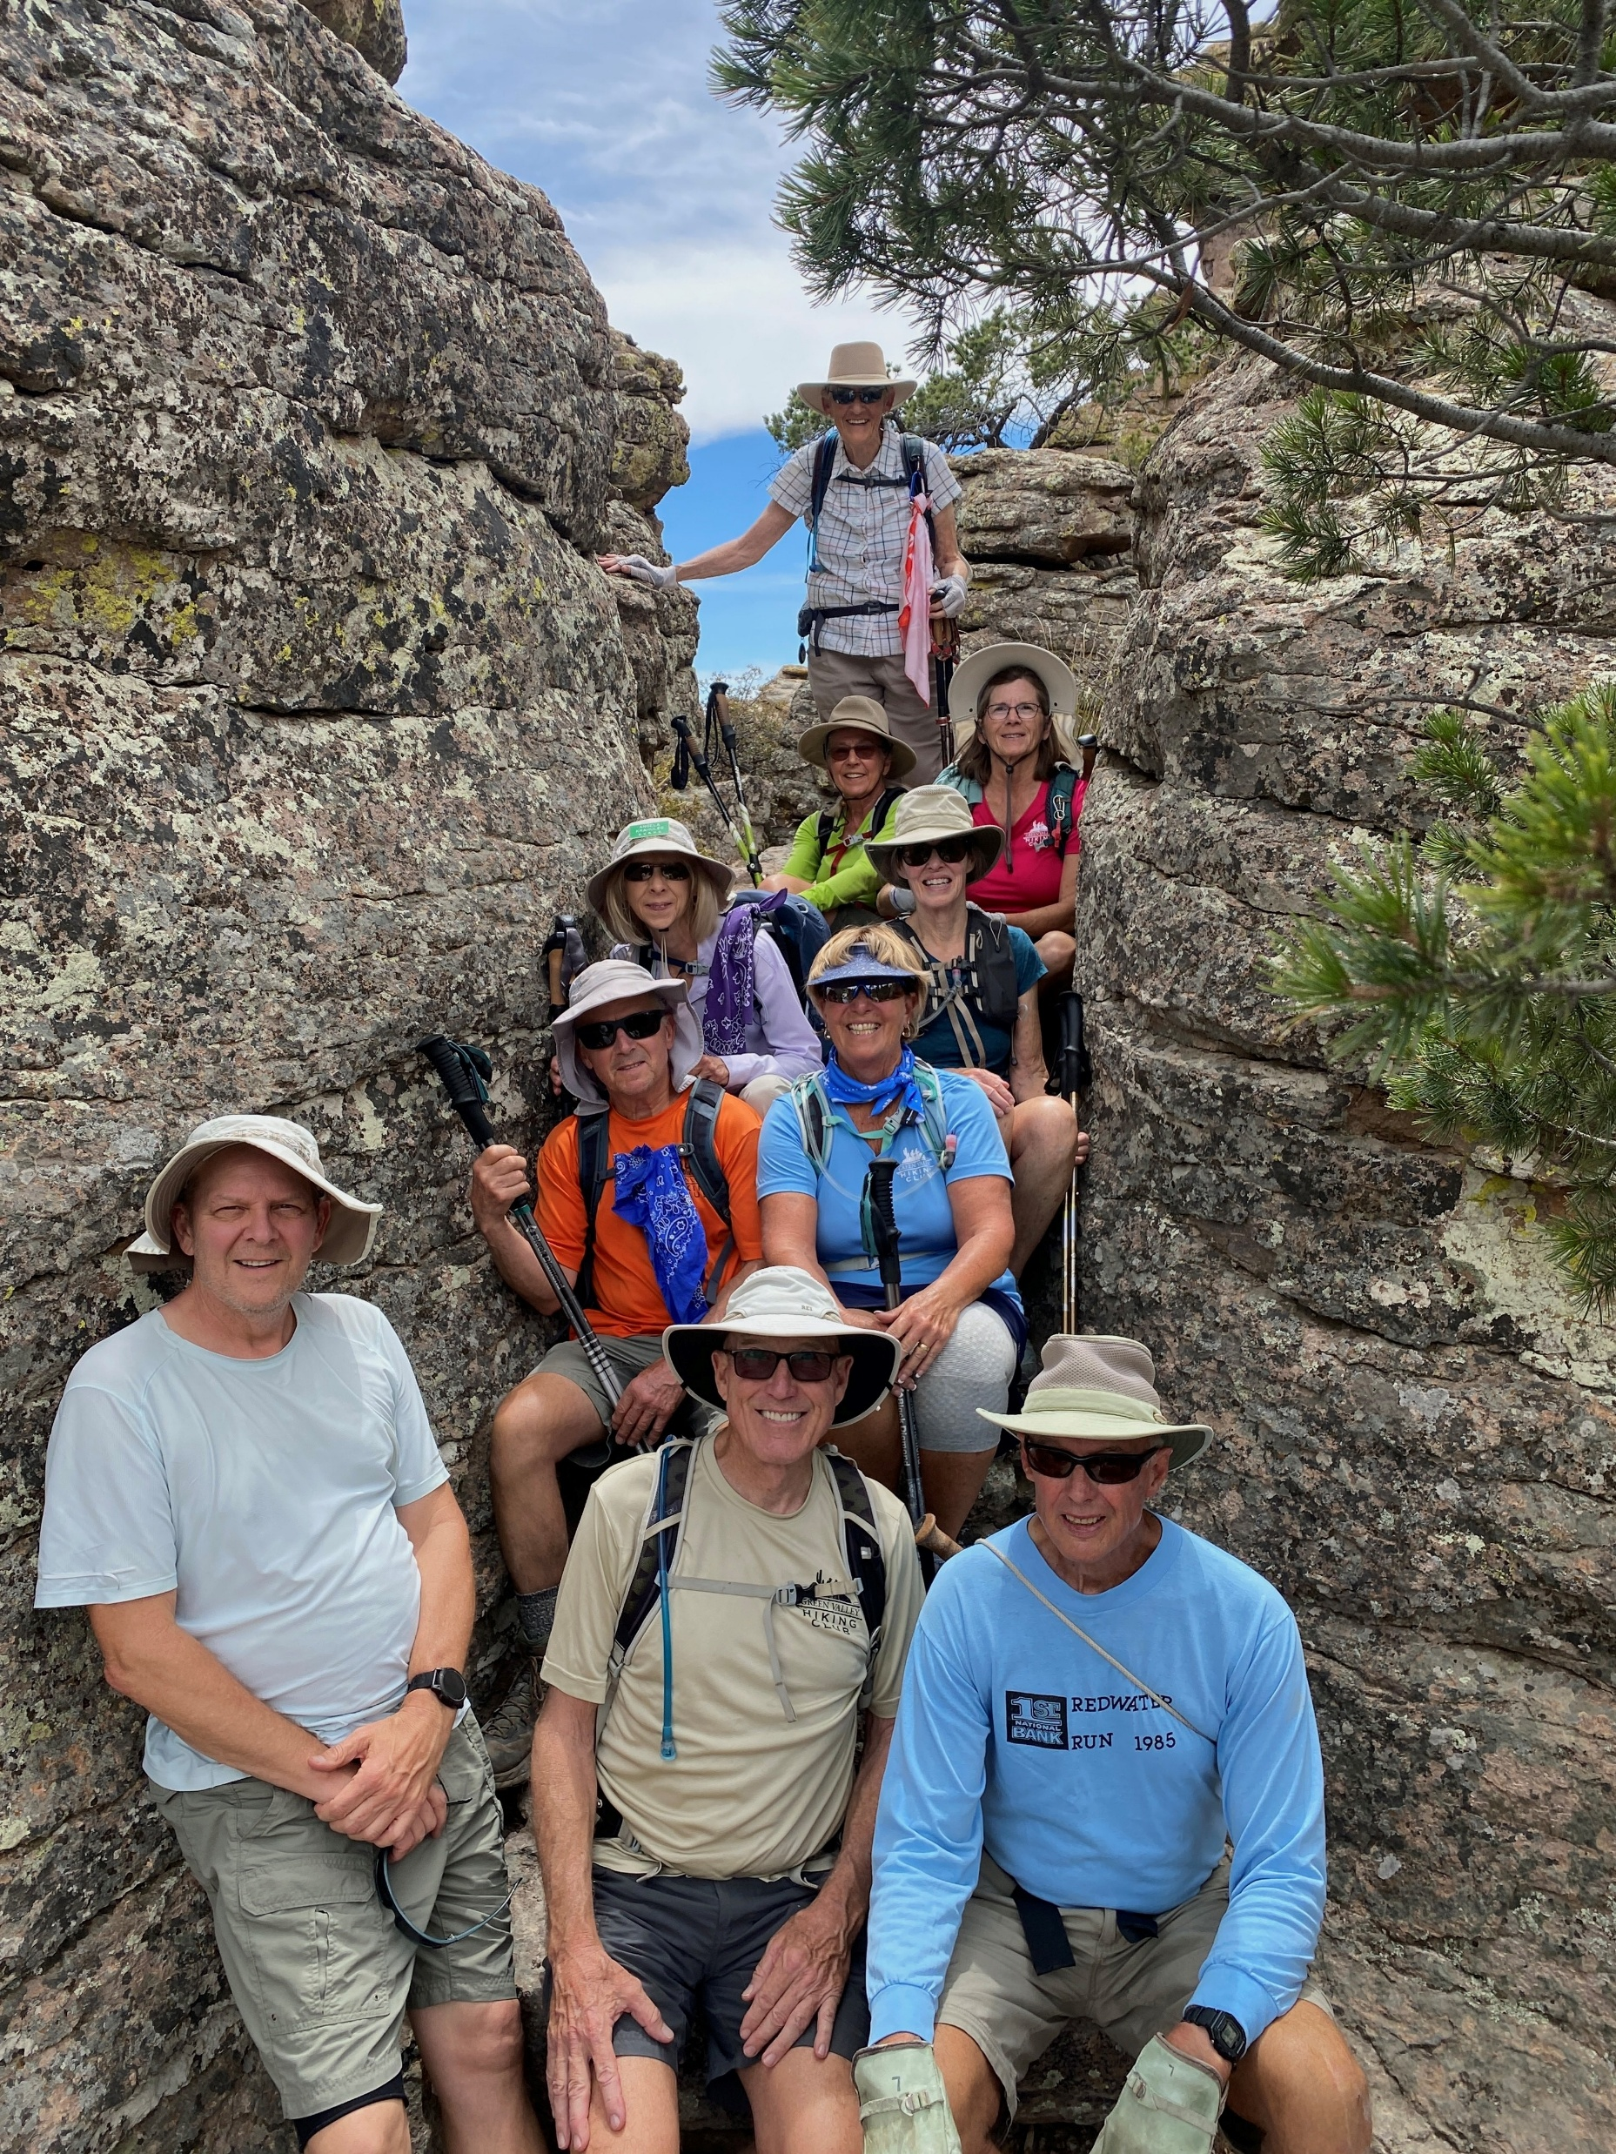

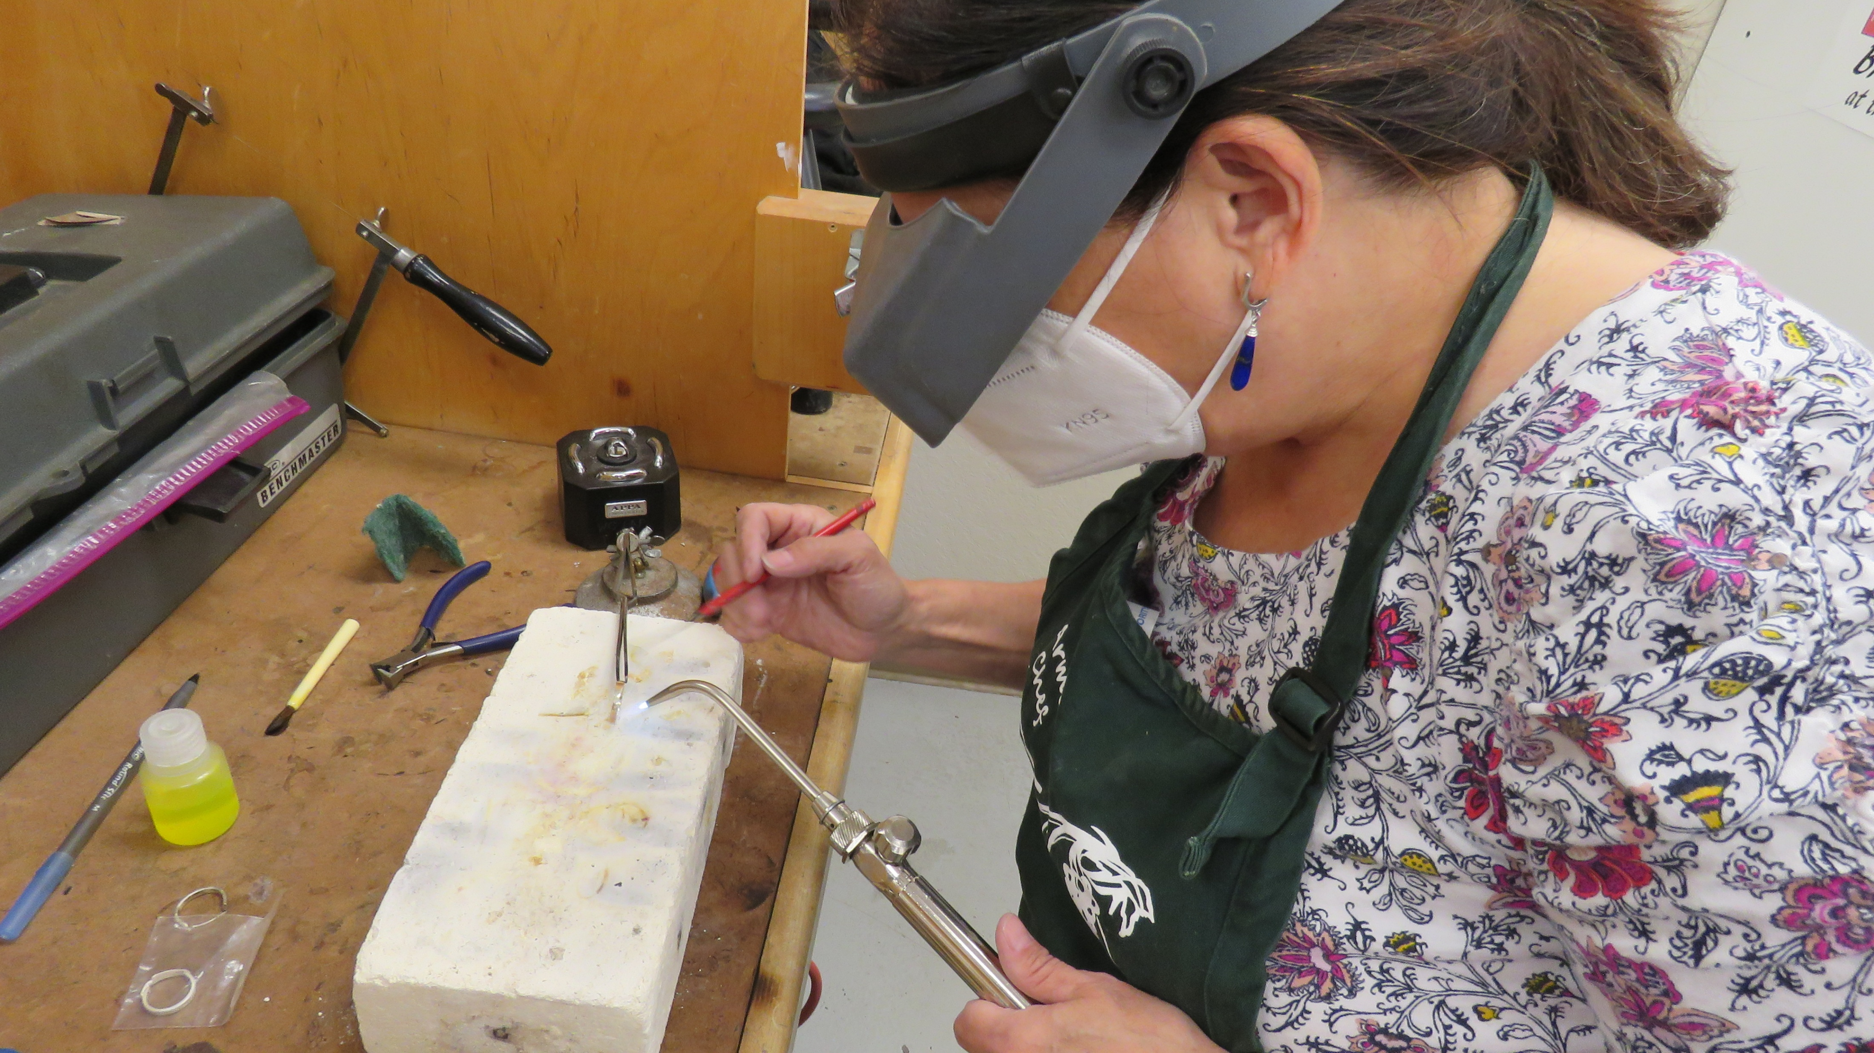
2025 Snapshot of GVR
GVR by the Numbers
6. Clay Studio, 447 members
7. Tennis, 392 members
8. Hiking, 383 members
9. Meditation, 363 members
10. Lapidary, 359 members
Notes:
Six: Clay Studio, increased by 89 members; Seven: Tennis, decreased by 15 members; Eight: Hiking, increased by 9 members; Nine: Meditation, increased by 34 members; Ten: Lapidary, decreased by 8 members. Forum was at number 6 for the 2024 report; replaced at number 10 by Lapidary.

Slide 27
2025 Snapshot of GVR
GVR by the Numbers
Clubs
15
Sports Clubs
3,000 members = 68 more than 2024
11
Arts & Crafts Clubs
2,365 members = 6 more than 2024
Special Interest Clubs
5
2,317 members = 84 more than 2024
Notes:
Organized by number of members. Special Interest Clubs are: Canine, Computer, Forum, Meditation, and Photography.

Slide 28
2025 Snapshot of GVR
GVR by the Numbers
9
Social Clubs
1,652 members = 112 more than 2024
12
Cards & Games Clubs
922 members = 33 fewer than 2024
3
Dance Clubs
261 members = 72 fewer than 2024
Notes:
Organized by number of members.

Slide 29
2025 Snapshot of GVR
GVR by the Numbers
Leisure Education
1060
Classes Offered
239 more than 2024
9,311
Enrollments
1475 more than 2024
191
Full Courses
8 more than 2024

Slide 30
2025 Snapshot of GVR
Fitness
6
Fitness Centers
230
Pieces of Large
Fitness Equipment

Slide 31
2025 Snapshot of GVR
GVR by the Numbers
14
Personal Trainers
Four more than 2024
3-4
Response Time in Days
(equipment repair)
15
Fitness Offerings
Four more than 2024
Notes:
Response time in days refers to response to equipment issues dependent on availability of parts (back orders and/or supplies). 3-4 days is the response time since July 2024.

Slide 32

2025 Snapshot of GVR
GVR by the Numbers
NEW! Therapeutic Massage
2
RMTs
35
Members enrolled
(Started November 2025)
Notes:
Response time in days refers to response to equipment issues dependent on availability of parts (back orders and/or supplies). 3-4 days is the response time since July 2024.

Slide 33
2025 Accomplishments

Slide 34

2025 Accomplishments
Santa Rita Springs Center
Pool: new plaster and deck
New garden

Slide 35
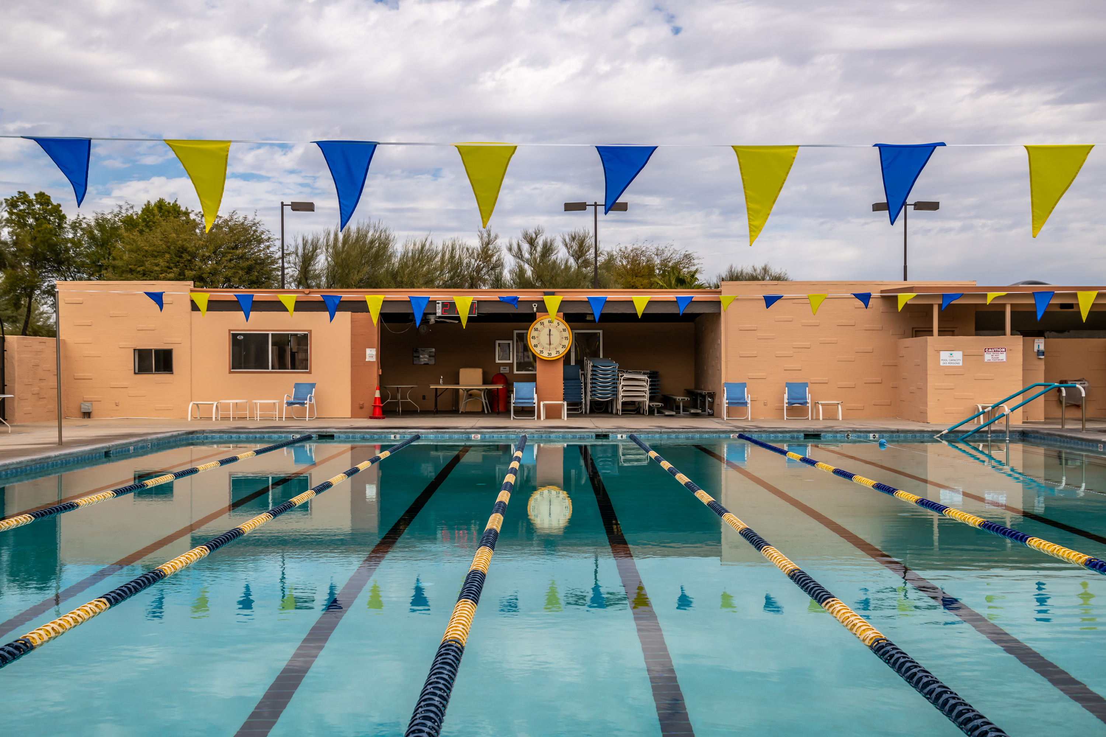
2025 Accomplishments
New heating and filtration equipment at West Center pool

Slide 36
2025 Accomplishments
Artisans’ Shop Expansion
New Metal Arts Shop

Slide 37
2025 Accomplishments
Campus-wide energy audit completed
Campus-wide accessibility assessment completed

Slide 38
2025 Accomplishments
Desert Hills locker room renovations
West Center landscaping renovation

Slide 39
2025 Accomplishments
Received a successful audit for the 2024 fiscal year with no findings or recommendations
Developed an enhanced 2026 budget document

Slide 40
2025 Accomplishments
Successfully developed recommendations to improve Board appointed committees and member appointment process, which was a Bylaws change approved by the members on the recent ballot.

Slide 41
2026 Goals
and Projects

Slide 42
2026 Goals and Projects
  Complete the lapidary consolidation project at West Center.
  Install cornhole courts at Canoa Ranch and East Center
  Install fencing at Pickleball Center to improve security
  Complete the kiln room expansion at the Desert Hills Ceramics Studio

Slide 43
2026 Goals and Projects
  Update flooring throughout
  Las Campanas
  Expand Las Campanas and Santa Rita Springs fitness centers
  West Center aquatics facilities rehab: new plaster, new decking, locker room facelift

Slide 44
2026 Goals and Projects
  Convert all lighting at Ceramics and Clay Studios to LED
  (per energy audit)
  Develop a five-year accessibility improvement plan
  (per assessment outcomes)

Slide 45
2026 Goals and Projects
  Create a successful GVR-operated café at the Del Sol Clubhouse

Slide 46
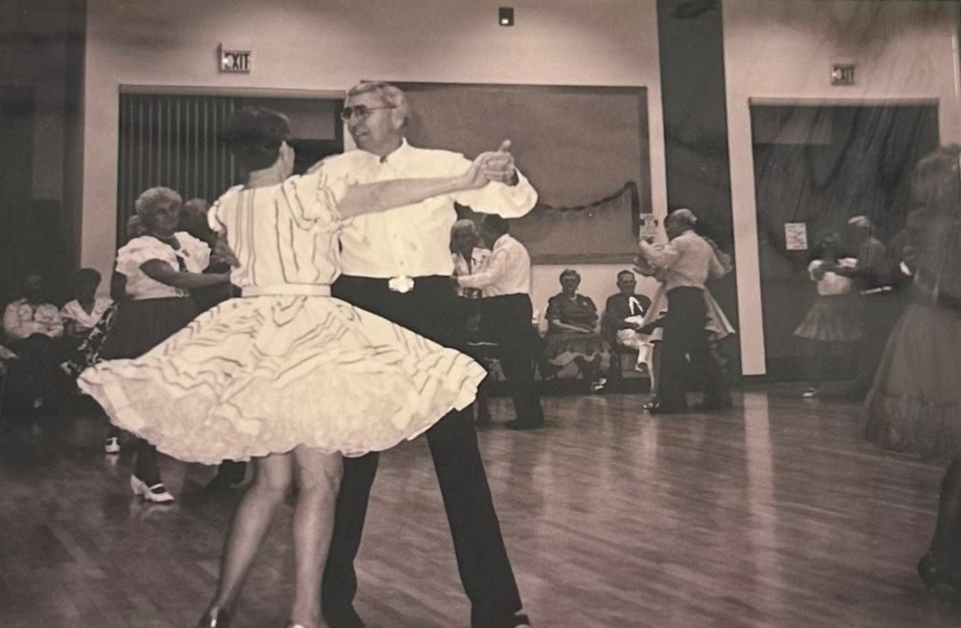
Thank you!

