Slide 1


Slide 2
Fiscal Affairs Committee (FAC) and Staff Recommended
2027 Budgets

Slide 3
2027 Budget Goals
The Proposed 2027 Budgets meet GVR’s mission of providing excellent facilities and services that create opportunities for recreation, social activities, and leisure education to enhance the quality of our members’ lives.
The Proposed 2027 Budgets meet Goal #4 of the Strategic Plan, to cultivate and maintain a sound financial base that generates good value for our members.
The 2027 Recommended Operations Budget is based on the actual expenditures that GVR anticipates for 2027, per Bylaws Article 3. Section 2.

Slide 4
2027 Budget Goals continued
Corporate Policy Manual (CPM)
Section 5.5.2
B. Annually, staff will prepare a tentative budget calendar based on a required budget approval of no later than November 15.
C. GVR shall annually adopt a balanced budget where operating revenues are equal to, or exceed, operating expenditures.

Slide 5
Budget Development
The Budget process began in August 2026 when the CEO and CFO met with each department director to review and discuss their budget needs and requests.
The Fiscal Affairs Committee (FAC) met with Clubs on August 18 to hear their capital requests.
The FAC reviewed the staff recommended Operating Budget and Fee Schedule on September 22.
The FAC reviewed the staff recommended Capital Improvement Plan and Capital Budget on September 29.

Slide 6
Fiscal Affairs Committee (FAC) and Staff Recommended
2027 Operations Budget and Fee Schedule

Slide 7
Key Components
Members’ 2027 dues rate increase $30 from current $545 to $575 (5.5%). This is an additional $2.50 per month, per household and was forecasted when developing the 2026 Budget.
Membership Change Fee and Initial Fee for 2027 increase from $3,200 to $3,300 (3.1%).
Personnel costs include a recommended $129,335 or 2.5% aggregate increase in wages and an increase of 4.0 full-time equivalents (FTE) for café and aquatics for a total of 92.45 FTE.

Slide 8
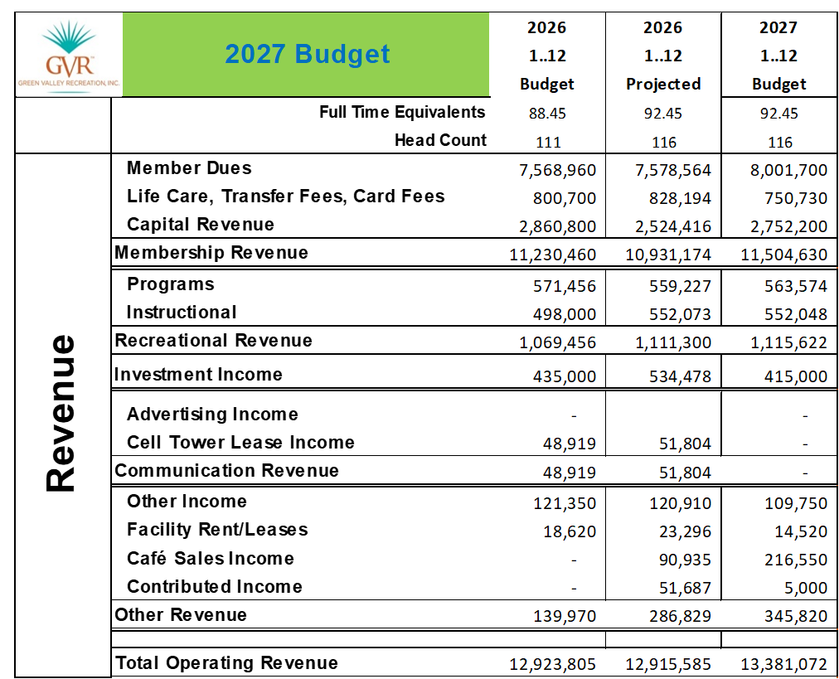
2027 Revenue Summary

Slide 9
Primary Revenue Sources
  2026 Capital Revenue budgeted at $2,860,800
  2026 projected Capital Revenue of $2,524,416
  A 2026 shortfall of $336,384
  2027 Capital Revenue budgeted at $2,752,200
  2026 – 2027 Budgeted Capital decrease of $108,600
  Capital Revenue is no longer a stable revenue source because of a significant decrease in housing sales. Therefore, Dues are increasing
  2026 – 2027 Budgeted Dues revenue increase of $433,136

Slide 10
Dues Forecast
Year | Forecasted Dues Rate | Forecasted Increase
2028 | $595 | 3.6%
2029 | $620 | 4.3%
2030 | $645 | 4.1%

Slide 11
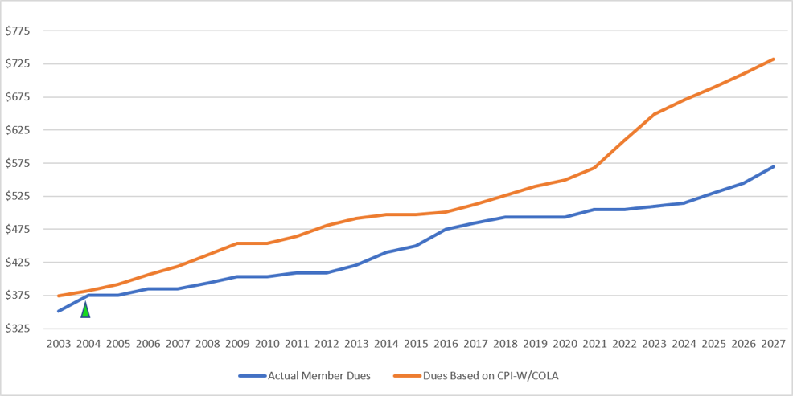
Dues increases have not kept up with cost of living (CPI) since 2004

Slide 12
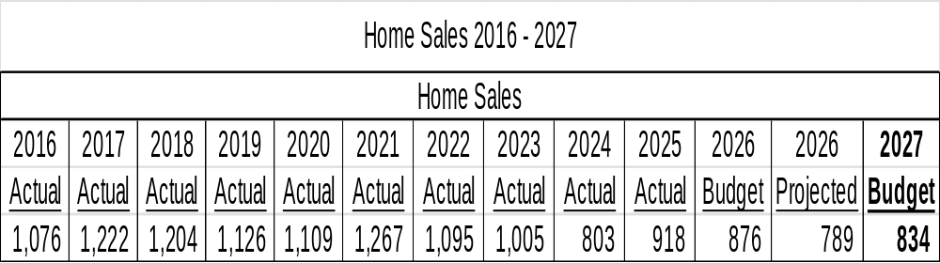
Home Sales and Overreliance on Capital Revenue

Slide 13
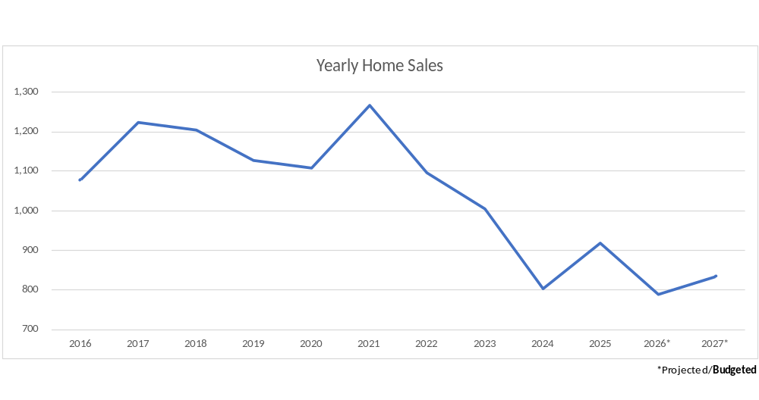
Home Sales and Overreliance on Capital Revenue

Slide 14
Home Sales and Overreliance on
Capital Revenue
How does this translate to real dollars?
Based on a recommended 2027 fee of $3,300.
From a high in 2021 of 1,267 to the 2027 Budget of 834, this difference is 433 home sales.
A reduction in projected revenue of $1,428,900 by comparison.

Slide 15
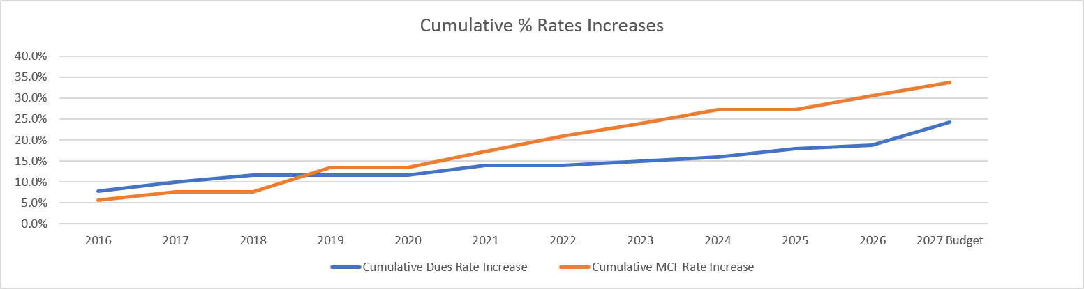
Dues increases versus to Capital Revenue increases
Starting in 2019, Capital Revenue rate increases have outpaced increases in Member Dues

Slide 16
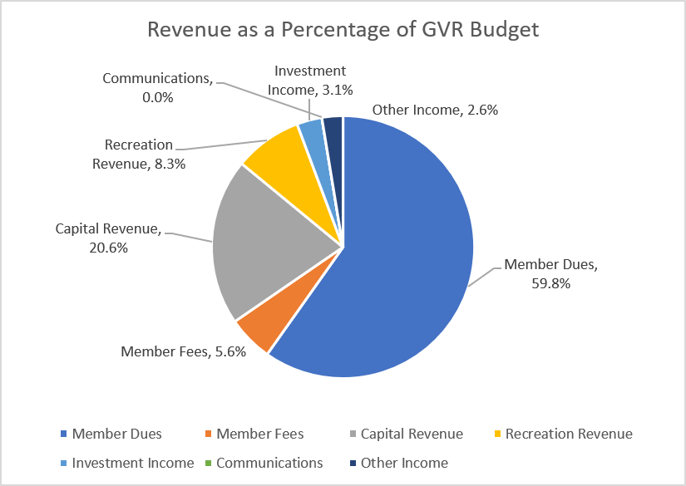
2027 Revenue Summary cont.

Slide 17
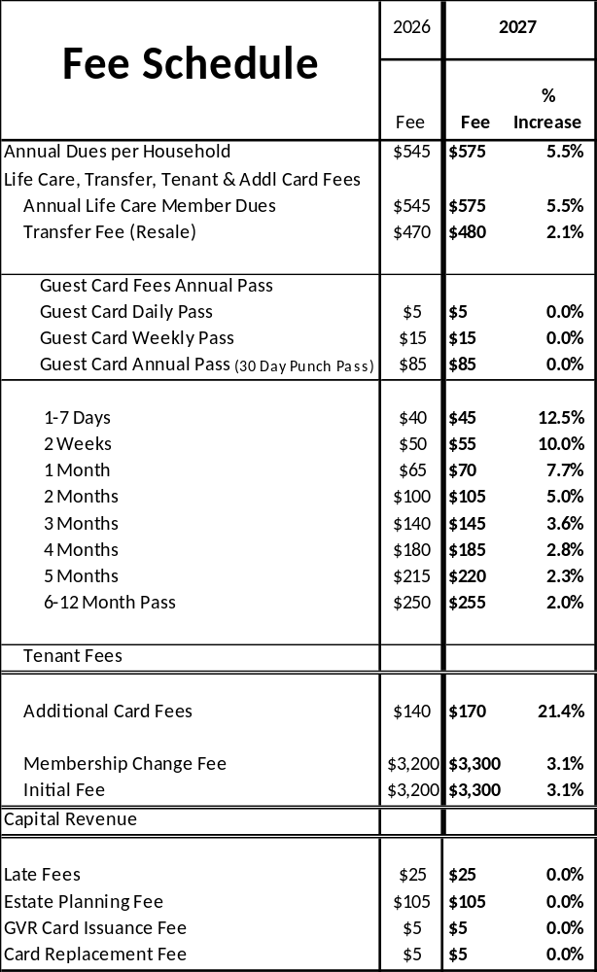
2027
Fee
Schedule
Percentage
Increases

Slide 18
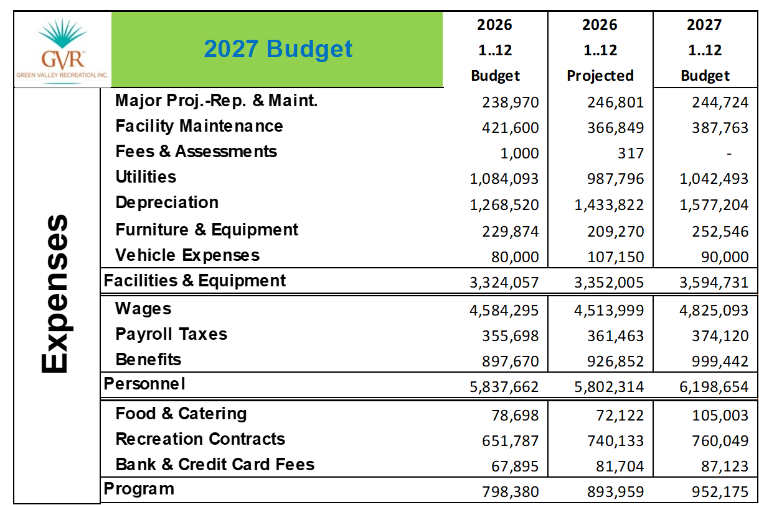
2027 Expense Summary (Part 1)

Slide 19
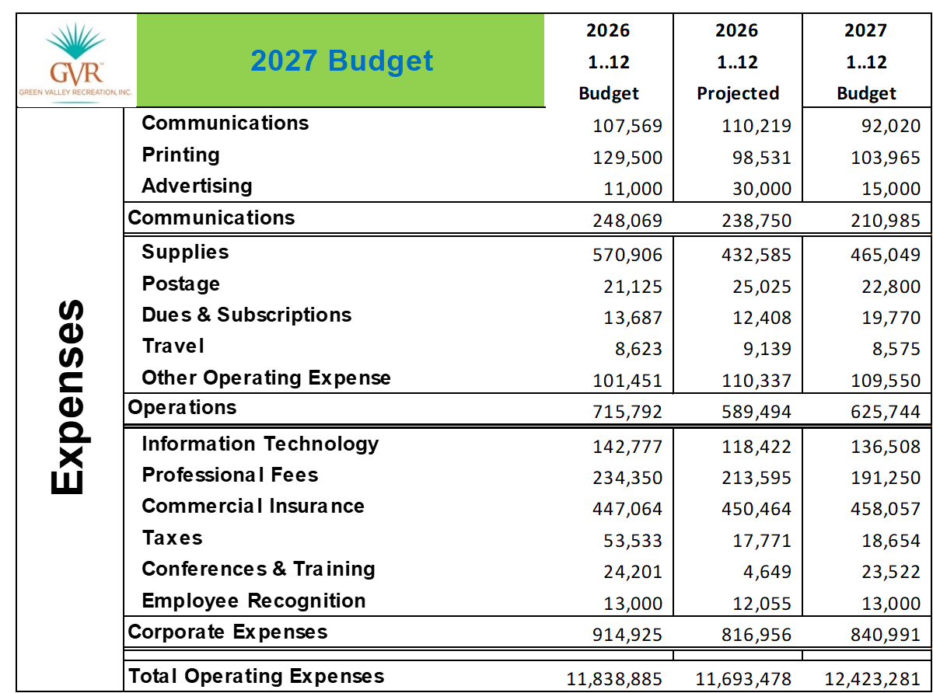
2027 Expense Summary (Part 2)

Slide 20
2027 Expense Highlights
$308,684 increase in Depreciation
Wages includes an additional 4 FTE and a 2.5% aggregate rate increase. Includes a 2% COLA and a 1% merit eligibility.
Employee Benefits includes a 5.0% mid year rate increase.
5.0% rate increase for commercial business insurance.
Increase in transfer from Operations to MRR-A of $108,000 for a total of $1,508,102
Increase in transfer from Operations to MRR-B of $23,995 for a total of $366,778
Total Operations expenses of $12,423,281

Slide 21
Board Approved Compensation Philosophy
GVR is committed to attracting and retaining the best available talent in service to GVR's strategic plan and the communities it serves. This Compensation Philosophy prioritizes: 1) competitive wages, 2) equitable pay among employees performing similar work, and 3) consideration of performance as a determining factor. It is supported through the development and standardized application of a Pay Plan.
The Pay Plan was designed to be market-driven and is based on a comprehensive analysis of GVR's relevant labor market.
GVR's compensation philosophy is to meet the labor market. Over the past four years, salaries have progressed from below-market levels to market alignment.
The Compensation Philosophy and Pay Plan will be reviewed annually and adjusted as needed to continuously balance competitive pay with organizational goals, as well as to respond to changes within the labor market.

Slide 22
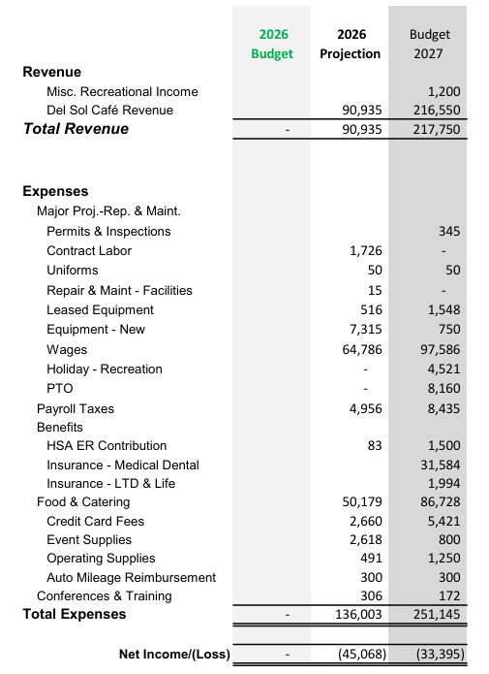
Clubhouse Café

Slide 23
FAC and Staff Recommendation
Board Option #1:
Approve the FAC and Staff Recommended 2027 Operating Budget and Fees Schedule as presented.

Slide 24
Recommended Motion
I move to approve the FAC and Staff Recommended 2027 Operating Budget and Fees Schedule as presented.

Slide 25
Fiscal Affairs Committee (FAC) and Staff Recommended
2027 Capital Improvement Plan (CIP) and Capital Budget

Slide 26
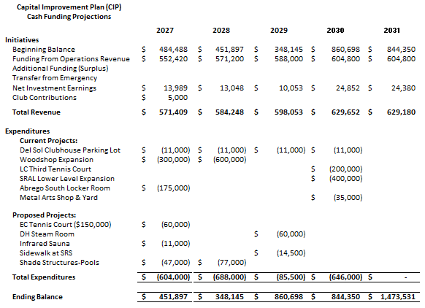
5 Year Capital Improvement Plan

Slide 27
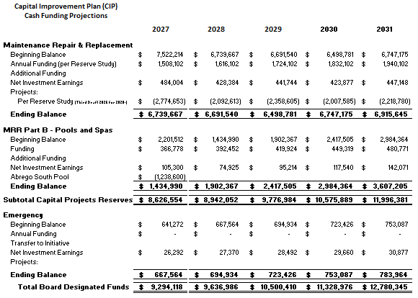
5 Year Capital Improvement Plan cont.

Slide 28
Maintenance, Repair, & Replacement Fund (MRR-A)
The Reserve Study recommended increases to annual funding due to increased annual expenditures resulting from:
  Increased execution of the plan
  Inflationary pressures.
The annual budgeted contributions to the MRR-A Fund from the Operations Fund have been increased $108,102 for 2027 for a total of $1,508,102 with additional escalations for future years.
Per the CPM: The target total balance of the MRR-A fund shall be at or about 25 percent of the total replacement cost with a target of at or about 70 percent of the fully funded balance calculated with the Annual Reserve Study. Based on the most recent MRR-A Reserve Study draft, the fund is at 28.83 percent of total replacement cost and at 47.6 percent of the fully funded balance.

Slide 29
Maintenance, Repair, & Replacement Fund (MRR-A)
Reserve Funding Outlook per Browning Reserve
The funding plan is sustainable and appropriately structured. Reserve contributions increase by 7.7% annually for five years. While above inflation, these measured increases position the fund for long-term stability. Beginning in 2032, contribution growth moderates to 3.1%, close to the study’s 2.5% long-term inflation assumption.
The plan maintains a substantial cash-flow buffer. The reserve balance remains above $4 million throughout the study period, reaching its low point of approximately $4.4 million in 2029. This minimum represents roughly 18% of the current $24.5 million cost to replace the entire reserve inventory. Thereafter, the balance recovers to more than $5 million and ultimately grows to $15 million.
Percent Funded in Context
Percent Funded should be treated as a secondary metric for an association with such a large and diverse inventory. It is a snapshot of the fund balance relative to accumulated component deterioration; it does not evaluate the adequacy of future reserve contributions.
An association dominated by one major, infrequent project may need to remain near 100% funded because nearly the entire project cost must be accumulated before the work occurs. GVR is at the other end of the spectrum: it has many components, staggered replacement cycles, and an ongoing stream of projects and contributions. Accordingly, cash-flow adequacy, contribution sustainability, and the minimum projected balance are more meaningful indicators of its ability to meet future obligations.
A helpful analogy is that Percent Funded is like a vehicle’s gas gauge: it shows how much fuel is currently in the tank but does not account for the fuel that will be added during the trip. The contribution plan represents that continuing fuel supply. For this reason, the planned contribution growth and the minimum cash balance provide a more complete view of long-term reserve health.
Best-Practice Planning
This year’s update demonstrated a reserve-planning best practice. Rather than focusing only on current-year expenditures, GVR staff closely reviewed the projects planned for 2027 and worked directly with the reserve analyst to incorporate the latest information into the study. This forward-looking coordination improves near-term budget accuracy and helps ensure that project timing, scope, and funding expectations remain aligned.

Slide 30
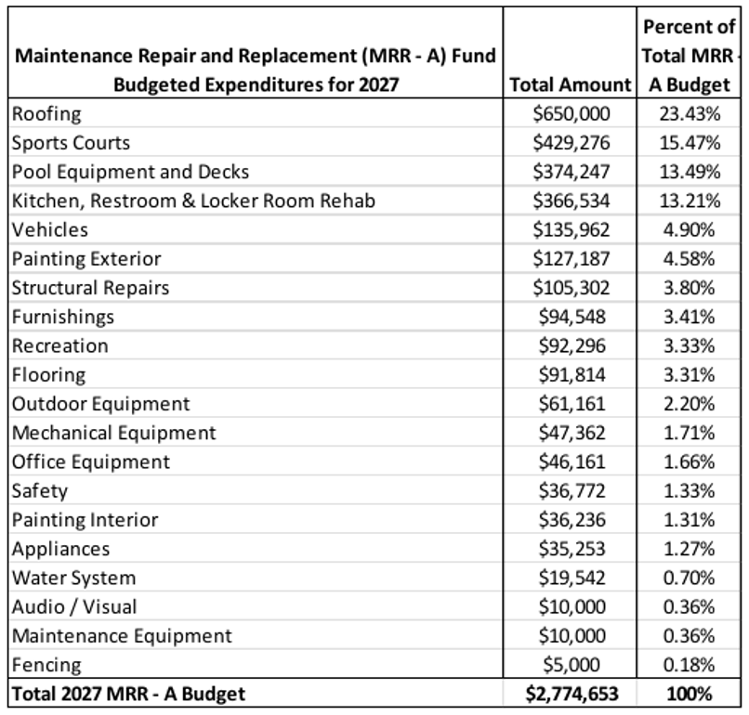
Budgeted 2027 MRR-A Projects

Slide 31
MRR – B Replacement of Pools & Spas
The annual budgeted contributions to the MRR-B Fund from the Operations Fund have been increased $23,995 for 2027 for a total of $366,778 with additional escalations for future years.
The only expenditure planned in 2027 is payment for the ABS pool and spa replacement at $1,238,600.

Slide 32
MRR – B Replacement of Pools & Spas
Analysis based on cost per square foot.
Life expectancy of a pool is assumed to be 50 years except if a pool has been replastered within the last 12 years, in which case, 12 years was added to the life expectancy of a pool from the date of replaster. This currently applies to CP1, DH, and WC.
Analysis assumes a 3% inflation escalation beginning with a cost per square foot of $550 in 2027.
Cash flow assumes a 7% additional contribution through 2033 and then decreases to 3% in 2034.
Cash flow assumes first payment for ABS to occur in 2027.
Per the CPM, The target total balance of the MRR-B fund shall be at or about 25 percent of the total replacement cost with a target of at or about 70 percent of the fully funded balance
The fund is at 11.2% percent of total replacement cost and at 11.04% percent of the fully funded balance.
With cell tower lease buy out, the total replacement cost would increase to 15.83% and the fully funded balance would increase to 15.61%.

Slide 33
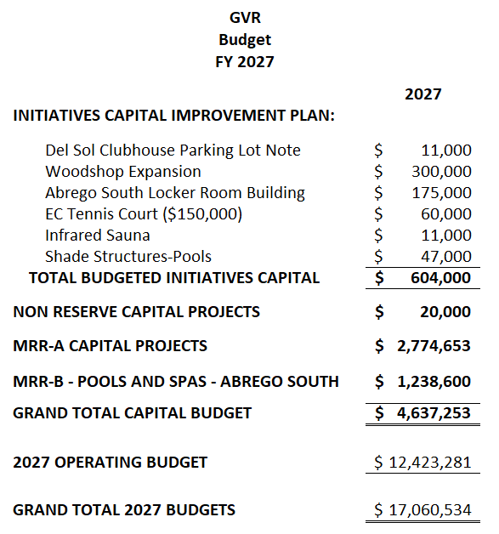
FAC and Staff Recommended
Capital Budget of $4,637,253

Slide 34
FAC and Staff Recommendation
Board Option #1:
Approve the FAC and Staff Recommended 2027 Capital Budget and Capital Improvement Plan presented.

Slide 35
Recommended Motion
I move to approve the FAC and Staff Recommended 2027 Capital Budget and Capital Improvement Plan as presented.

